Slide 1
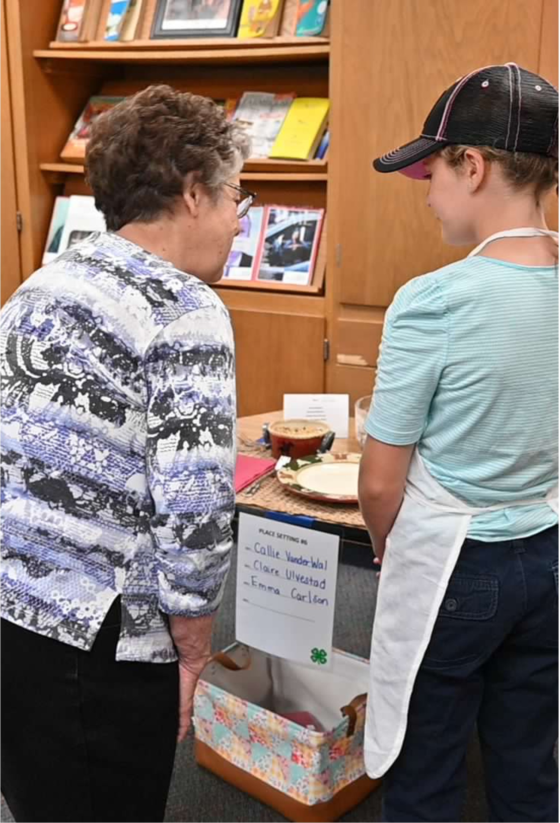
4-H Special Foods Workshop
Welcome!
Presentation a product of the 4-H Special Foods Committee

Slide 2
What is the Special Foods Contest?
Prepare recipe from one food group
  Food must contain one serving of a food group
  Recipe should provide 2-6 servings
90 minutes to complete four parts of contest
Notes:
Contest objectives & rules can be found starting on page 2 of the Special Foods Handbook. These bullets come from "General Contest Rules" found on page 2.

Slide 3
Dietary Guidelines for Americans
Notes:
More information about the Dietary Guidelines can be found online at https://cdn.realfood.gov/DGA.pdf

Slide 4
Selecting the Recipe
Select your recipe for a personal reason
  A favorite
  A challenge
  Falls into your favorite food group
Has at least 3 ingredients to be measured
Meets 2-6 servings
Fits the time frame of the contest
Notes:
More details about selecting the recipe start on page 12. The best way to determine if a selected recipe is appropriate for the contest is by using the Serving Size Worksheet (found in the contestant packet). Original recipes may be modified to fit the criteria; including doubling or cutting in half so that the number of servings falls within the 2-6 range.

Slide 5
Revive with 5 Challenge
Recipe must meet the minimum requirements of the special foods contest (as outlined in the handbook and scoresheet).
Prepare a recipe with 5 or fewer (minimum of 3) ingredients.
Answer challenge related questions (found on the scoresheet)
Notes:
The Revive with 5 [or Fewer Ingredients] Challenge promotes healthy eating habits and encourages busy families to cook at home. By preparing quick and easy recipes that meet recommended servings and promote healthy eating patterns, families have more quality time to spend at the dinner table.
It's like a recipe for a perfect family gathering! By sharing meals at home and cooking together, we build stronger bonds and make room for meaningful conversations. It's a healthy habit that nourishes both our bodies and our relationships.
Challenge Highlights/Key Points:
Recipe must meet the minimum requirements of the special foods contest (as outlined in the handbook and scoresheet).
Participating members will prepare a recipe with 5 or fewer (minimum of 3) ingredients.
Participants will be asked additional/challenge related questions with their own set of points. These points will be used to determine a top recipe from the shift and will have no impact on the 100 points associated with the contest score and ribbon placing.
The Revive with 5 challenges will be held during the following shifts:
Shift 7; Friday from 2:30 – 4 pm
Shift 10; Saturday from 12:30 – 2 pm
Non-Revive with 5 challenge recipes scheduled in Shift 7 or Shift 10 might be reassigned to make room for challenge participants.
Revive with 5 recipes entered in another shift will not be eligible for awards.

Slide 6
Contest consists of 4 parts:
Technique
Aesthetics and Hospitality (Place setting)
Food Quality
Nutrition Interview
Notes:
Technique can be found in the book starting on page 2. The technique portion of the contest happens in the kitchen is evaluated by the judge interacting with 4-H members while they are preparing their recipe.
Technique judges will ask questions of the 4-Her relative to measuring, food safety, proper use of a meat thermometer, and other preparation topics. The technique portion of the scoresheet accounts for 20-30% of the total score, based on age group.

Slide 7
Technique
Grooming
  Wear an apron
  Wash hands
  Hair covering
  Shoe selection
Cover work surface
Supplies on tray covered with towel(s)
Dish rag on tray – trash bag – waxed paper/parchment paper
Keep work area neat
Notes:
Handwashing and personal grooming are important when working in the kitchen. These components contribute to food and personal safety.
To ensure a clean and sanitary workstation, participants must cover their work surface with waxed or parchment paper (see page 22). The use of counter cover promotes food safety in the contest setting.
The use of trays (large baking pans or other tray varieties) helps to keep workspace orderly. It is also a helpful way to work through the recipe without forgetting ingredients. Working from right to left (or left to right) ensures that ingredients are used once and not forgotten (this recommendation can be found on page 22 under Work Area: Organization, Neatness, and Safety). Covering trays and other equipment when away from the workstation also contributes to food safety.
**Helpful Hint: based on personal preference, set up tray (on your left or right) with all supplies (including ingredients) needed to make the recipe. Once the item (tool, supply, ingredient) has been used place it on the empty tray located on the opposite side of the workspace. Once all the items from tray 1 have been moved to tray 2 your recipe is more than likely done and ready for the final steps – serving, baking, blending, etc.
This information and more can be found on page 22 of the handbook.

Slide 8
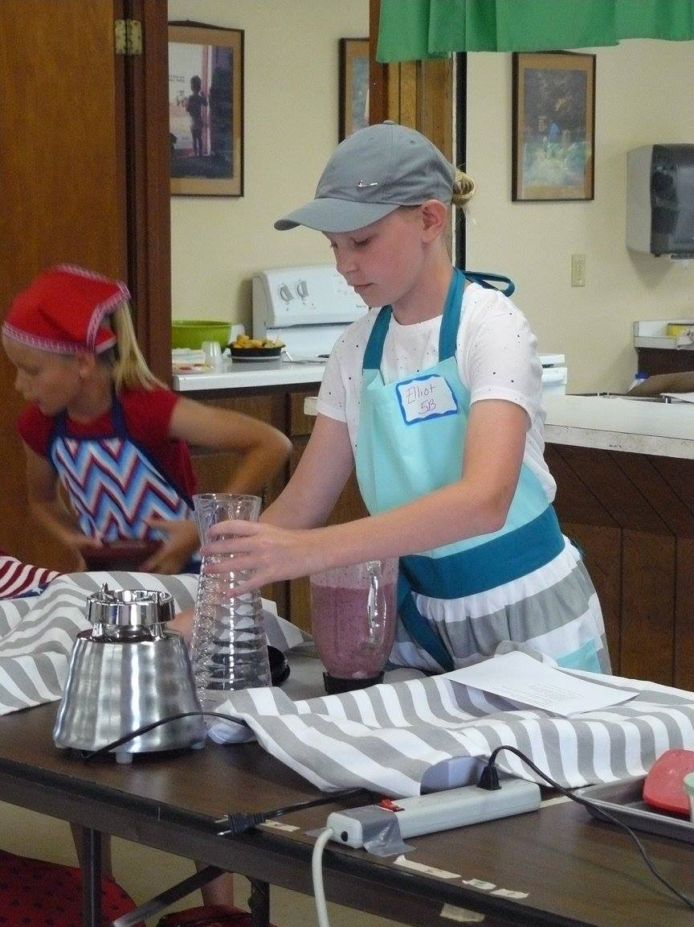
Technique: Kitchen Safety
Use dry potholders
Turn handles inward
Know how to use utensils & appliances
Watch for spills
See additional safety topics on page 29

Slide 9
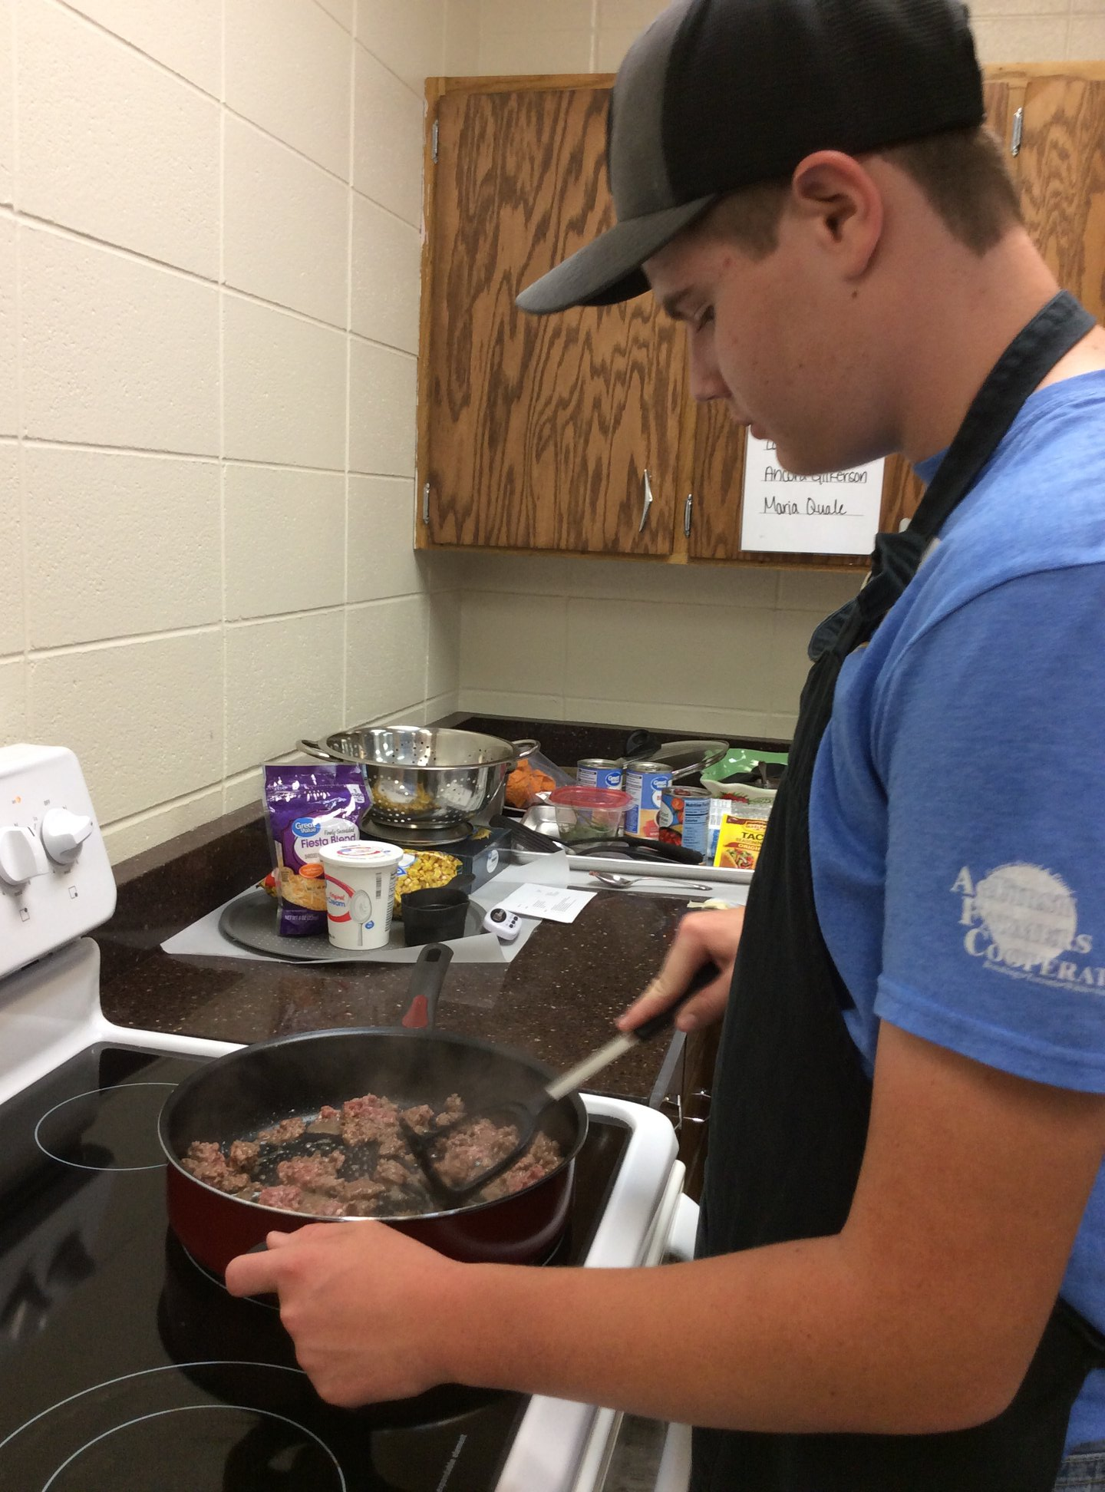
Technique: Food Safety
Wash fresh fruits and vegetables
Use meat thermometer
Avoid cross contamination
Gloves
Notes:
A meat thermometer is required for all recipes in the protein food group, including egg dishes.
To avoid cross contamination, cooks are encouraged to use a separate cutting board and knife for raw meat products. Yes, this adds to the list of things you should bring from home but food safety is of the utmost importance. It is also recommended that members wear disposable gloves when handling raw meat.
Speaking of eggs...there is an appropriate way to crack an egg for the contest! Yes, it does seem silly but be sure to review the steps on page 23 for properly cracking an egg. It's an 'egg-cellent' read!

Slide 10
Technique: Supplies/Equipment
Bring all supplies and equipment needed
Bring ingredients in their original container when possible
Measure at least three ingredients
No more than two ingredients can be pre-cooked, pre-cut or pre-measured
When measuring, use ‘catch-all’ under utensil
Use a cutting board, when needed
Notes:
Please pay special attention to the 'catch-all' when measuring. It's important to know that one should not measure over the bowl of ingredients in case there is a spill and too much of one ingredient gets added. It is very hard to separate or remove the excess. In this case, you might have to start over in order to have a successful recipe and you may not be prepared to do so – specifically enough ingredients to make a 2nd recipe.

Slide 11
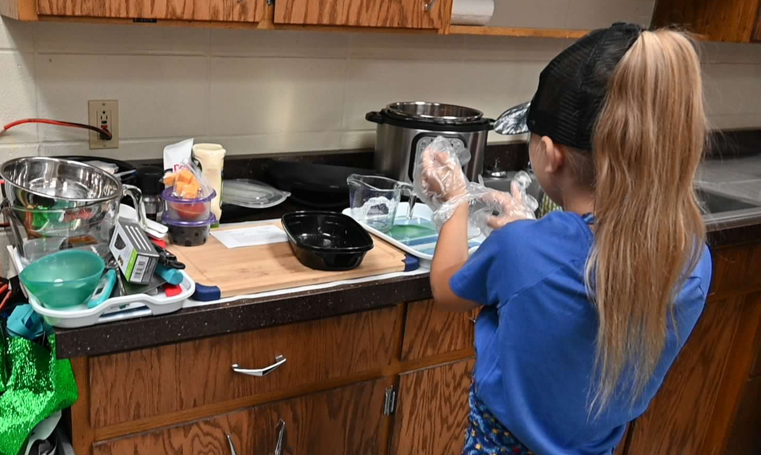
Technique: Workstation
Let’s set up our workstation
Notes:
At this point, allow youth to help set up the workshop workstation. This can be 1 station or multiple stations depending on the number of recipes planned for the workshop.
**In a workshop setting, don't be concerned with providing a limited amount of space like they might expect during the contest. Be sure they have ample space to include all members of the group. 1 group to an 8' table would be appropriate for this event.
**If having more than one recipe completed, take into consideration the complexity of the recipe. In this instance, less is more.

Slide 12
Contest consists of 4 parts: 2
Technique
Aesthetics and Hospitality (Place setting)
Food Quality
Nutrition Interview

Slide 13
Aesthetics & Hospitality
(Place Setting)
Work in 32-inch area
Include dinnerware and utensils needed to eat the meal planned (menu)
Placemat
Napkin
Serving Dish/Pitcher
Centerpiece (junior and seniors only)
Menu and Recipe
Notes:
When practicing at a local level, consider starting youth with basic supplies for a simple place setting. The use of plastic flatware, paper products (plate, napkin, cup), and large piece of paper (11x17" size) can serve as a placemat. This will give each member an opportunity to practice with a limited investment on your part. To establish a correct place setting, let members work where they are sitting. At this point in time don't be concerned with the serving dish/pitcher, centerpiece, menu, or recipe. We want them to learn how to set the table correctly first. There will be an opportunity to practice during slide 24 as well as several examples to discuss along the way.

Slide 14
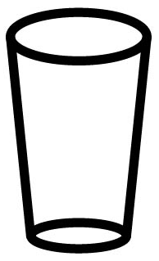
Place Setting Tips
Left = Fork
Right = Knife Spoon
Glass
Notes:
Hopefully these helpful tips of left and right will benefit you and your 4-H members when it comes to setting the table correctly.

Slide 15
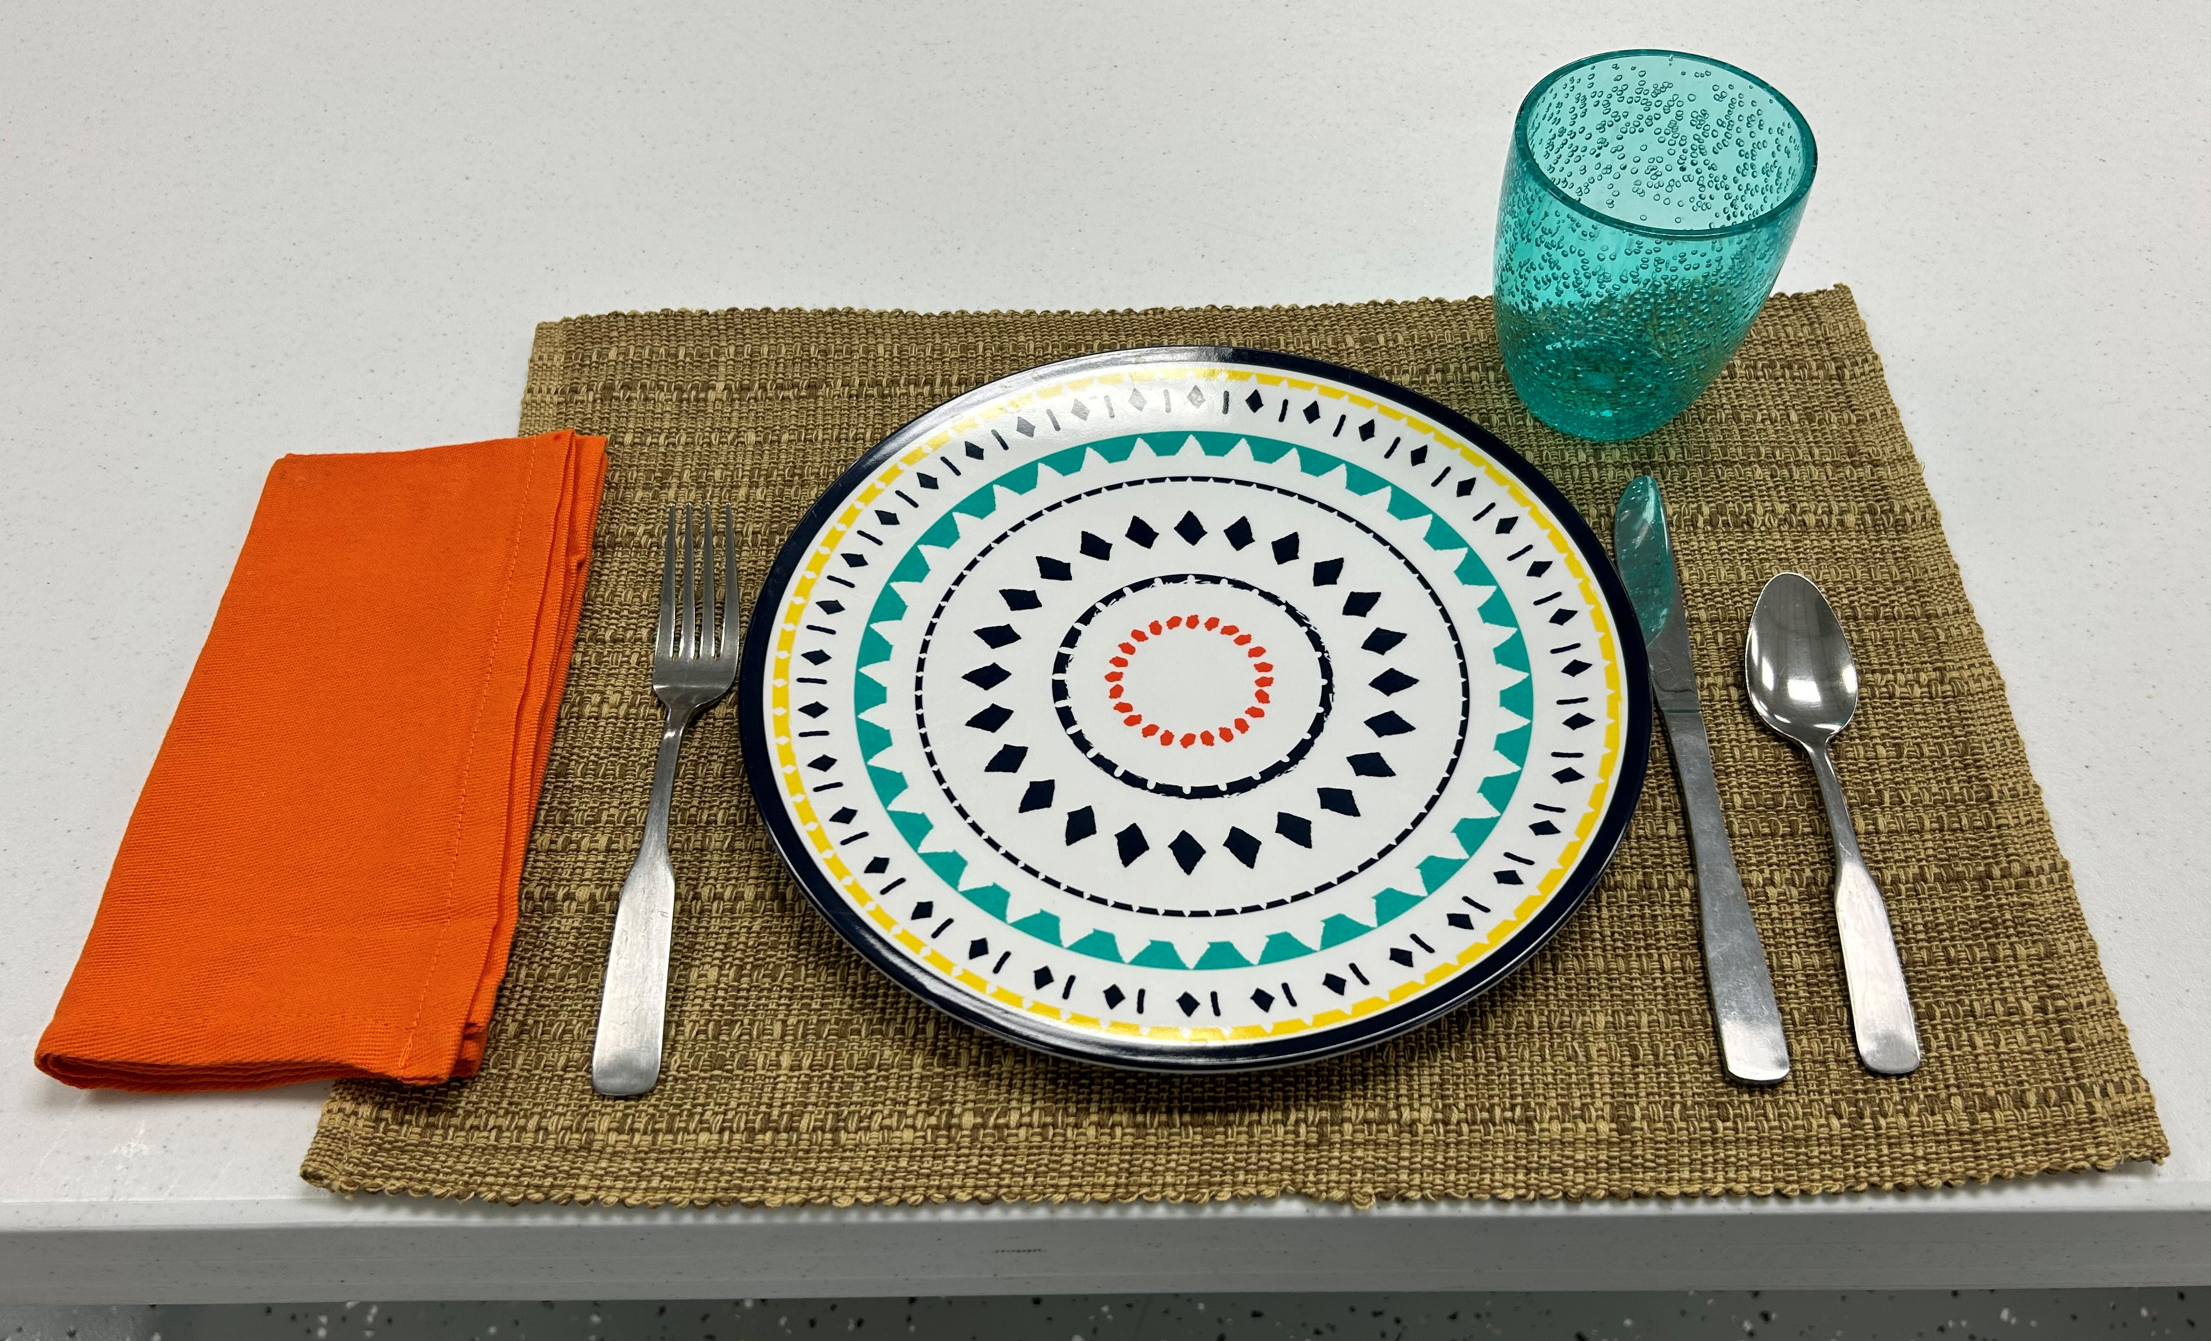
Proper Place Setting
Notes:
This is an example of a proper place setting (before the addition of serving dish/pitcher, centerpiece, recipe, menu)

Slide 16
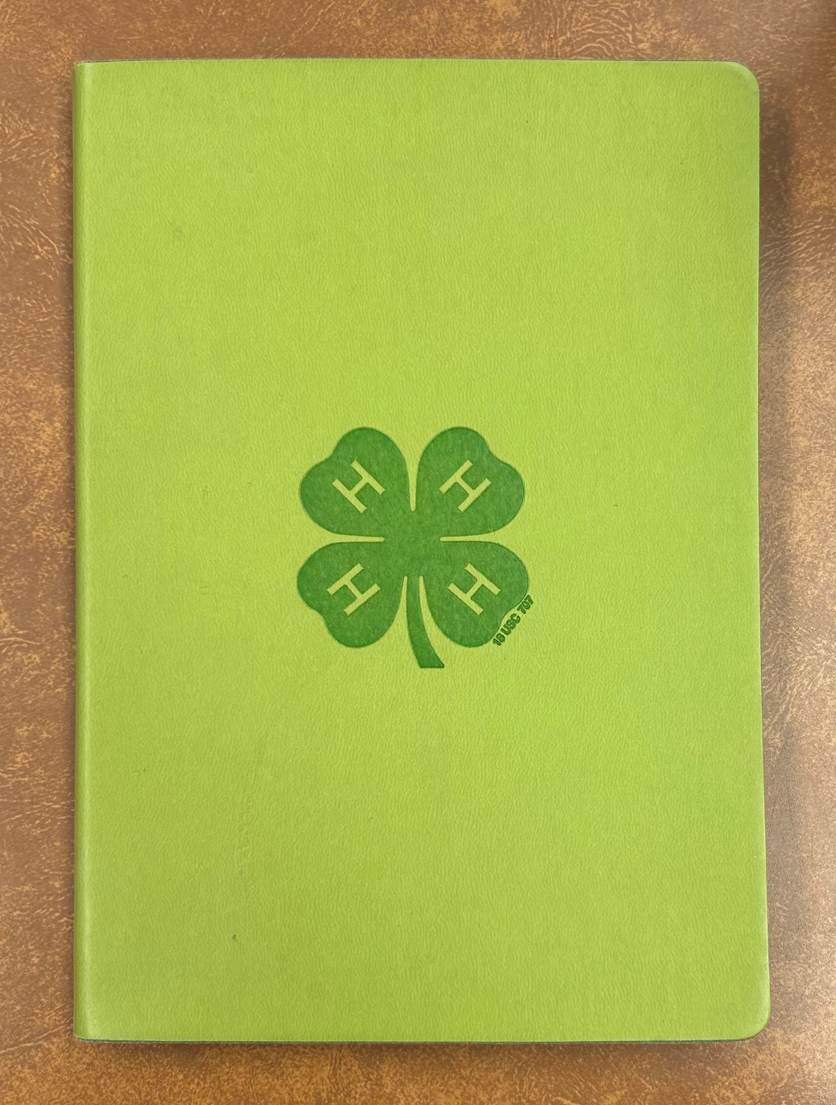
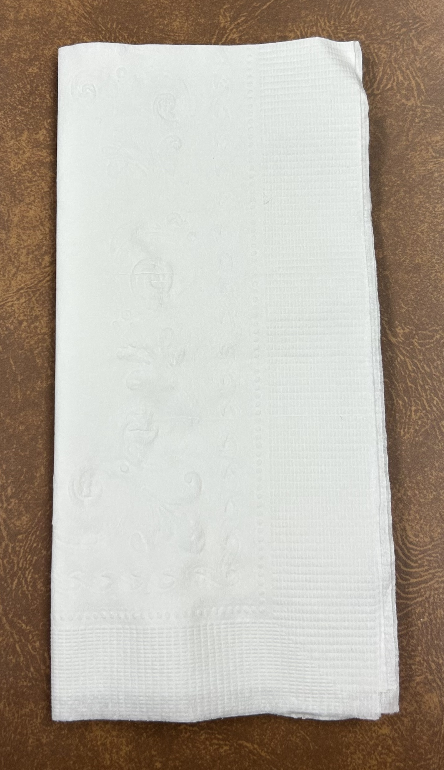
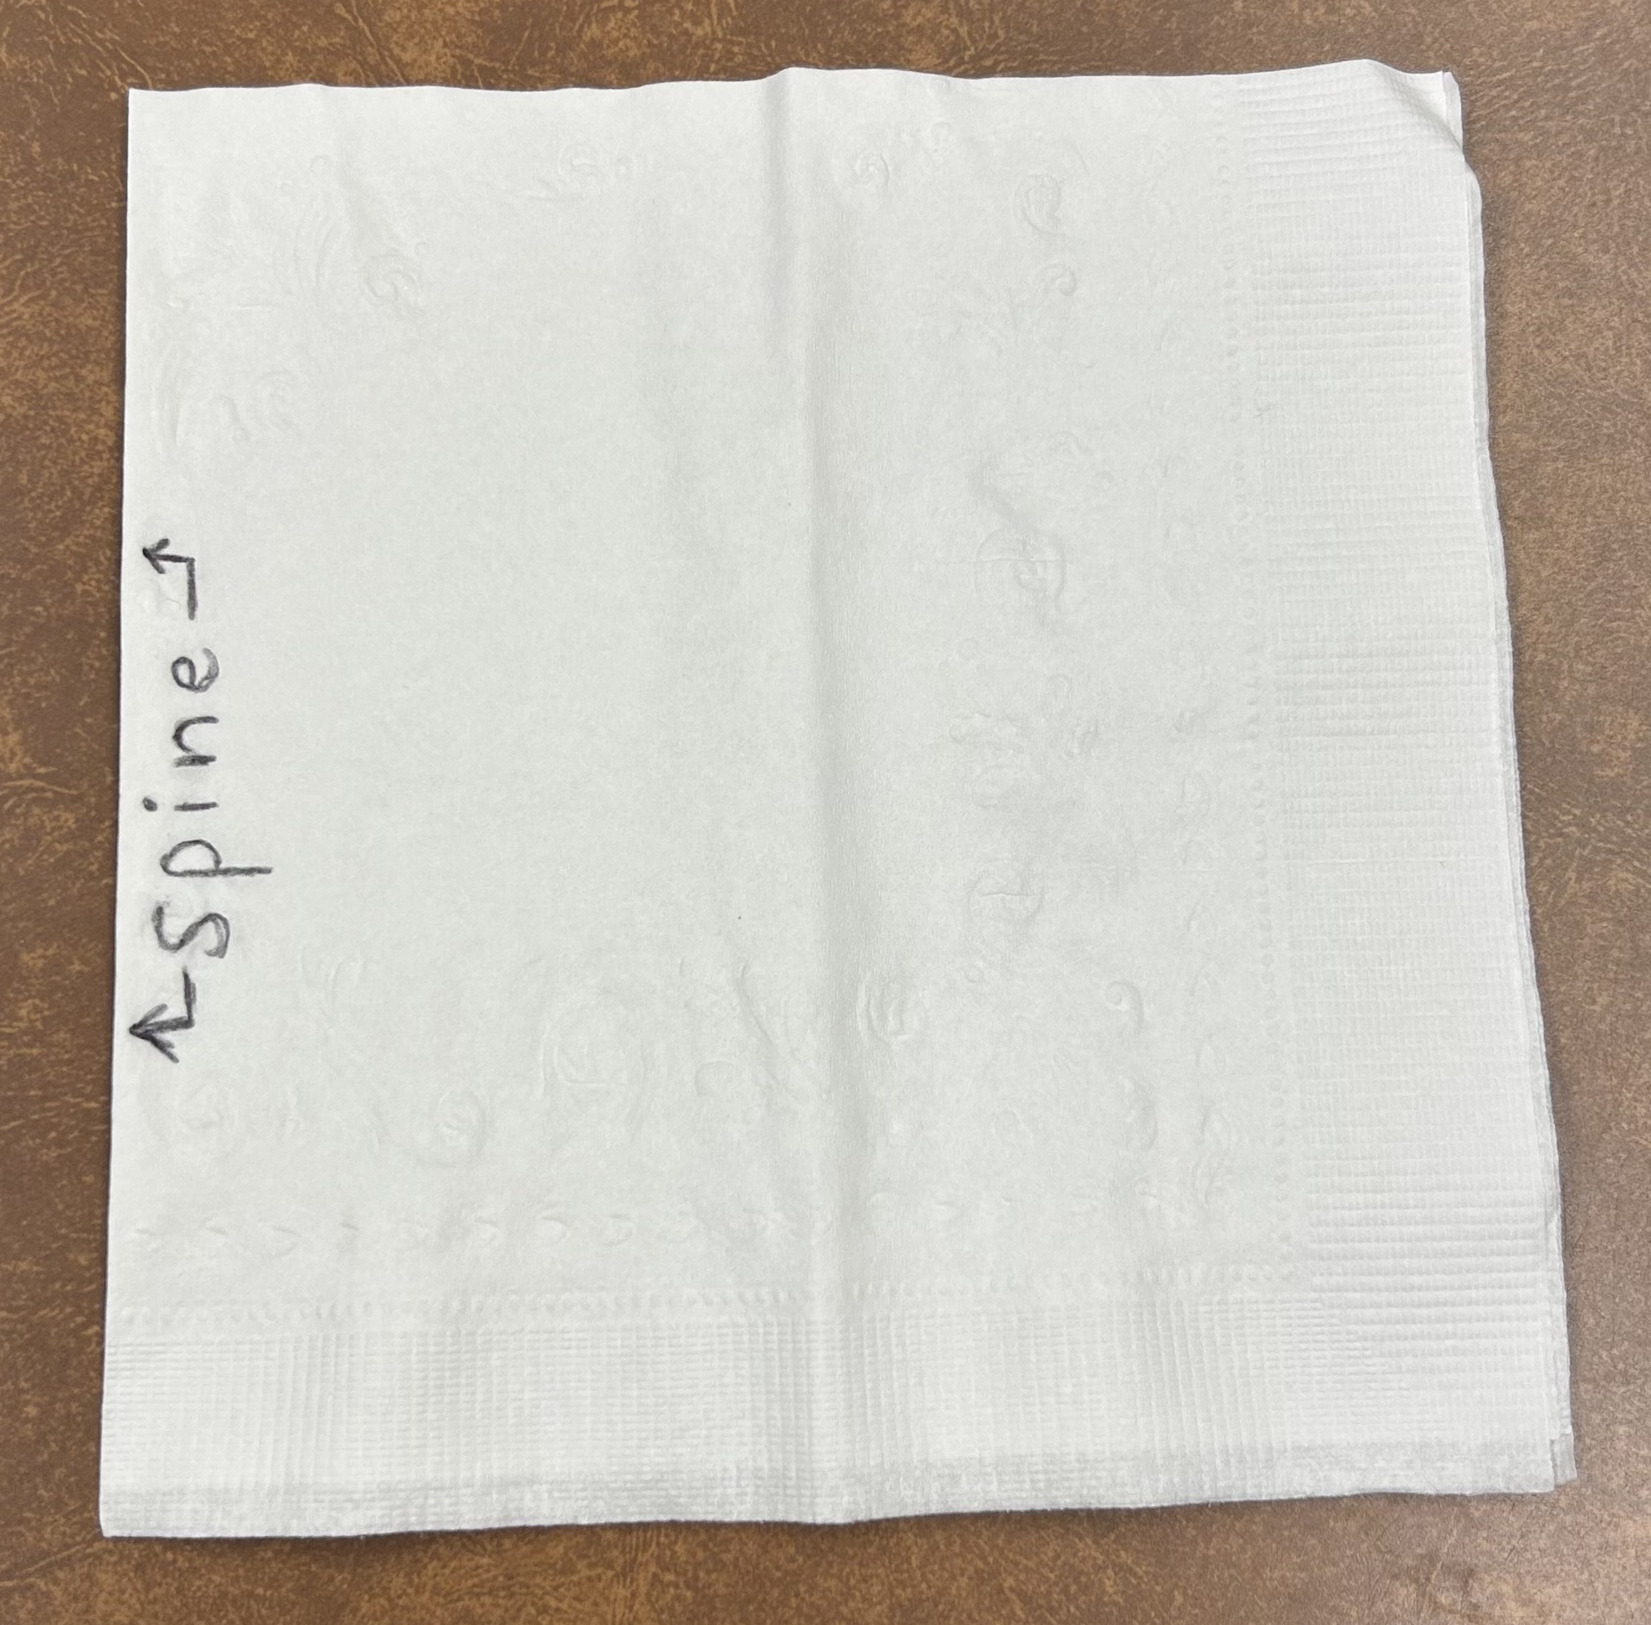
Napkin Folding
Notes:
You can try different folds with the napkin If you use the traditional fold/style, be sure the open corners of the napkin are in the lower right hand corner. Thinking of the napkin as a book will help. (see example on page 17).
**Provide your members with a paper napkin so they can practice.
Find the fold (that would be most like the spine of a book) and place on table so it is closest to their left hand, making sure there are 4 layers of paper napkin in the bottom right hand corner. If there are not 4 individual layers then they have the napkin upside down and need to flip it...keeping the solid fold at their left hand. Refer to the picture; the STAR is referring to the corner of the napkin being similar to thumbing through a book
Thinking a HOTDOG fold, fold the spine underneath/behind the napkin and line up the edges with the right side. You want to be able to pick up the napkin from the bottom right corner and watch the napkin 'unfold' so it can be placed across your lap.
A dinner napkin is 20”, 22” or 24” square A luncheon
napkin is 17” square and a tea napkin is 12” square
Do NOT place anything on top of the napkin

Slide 17
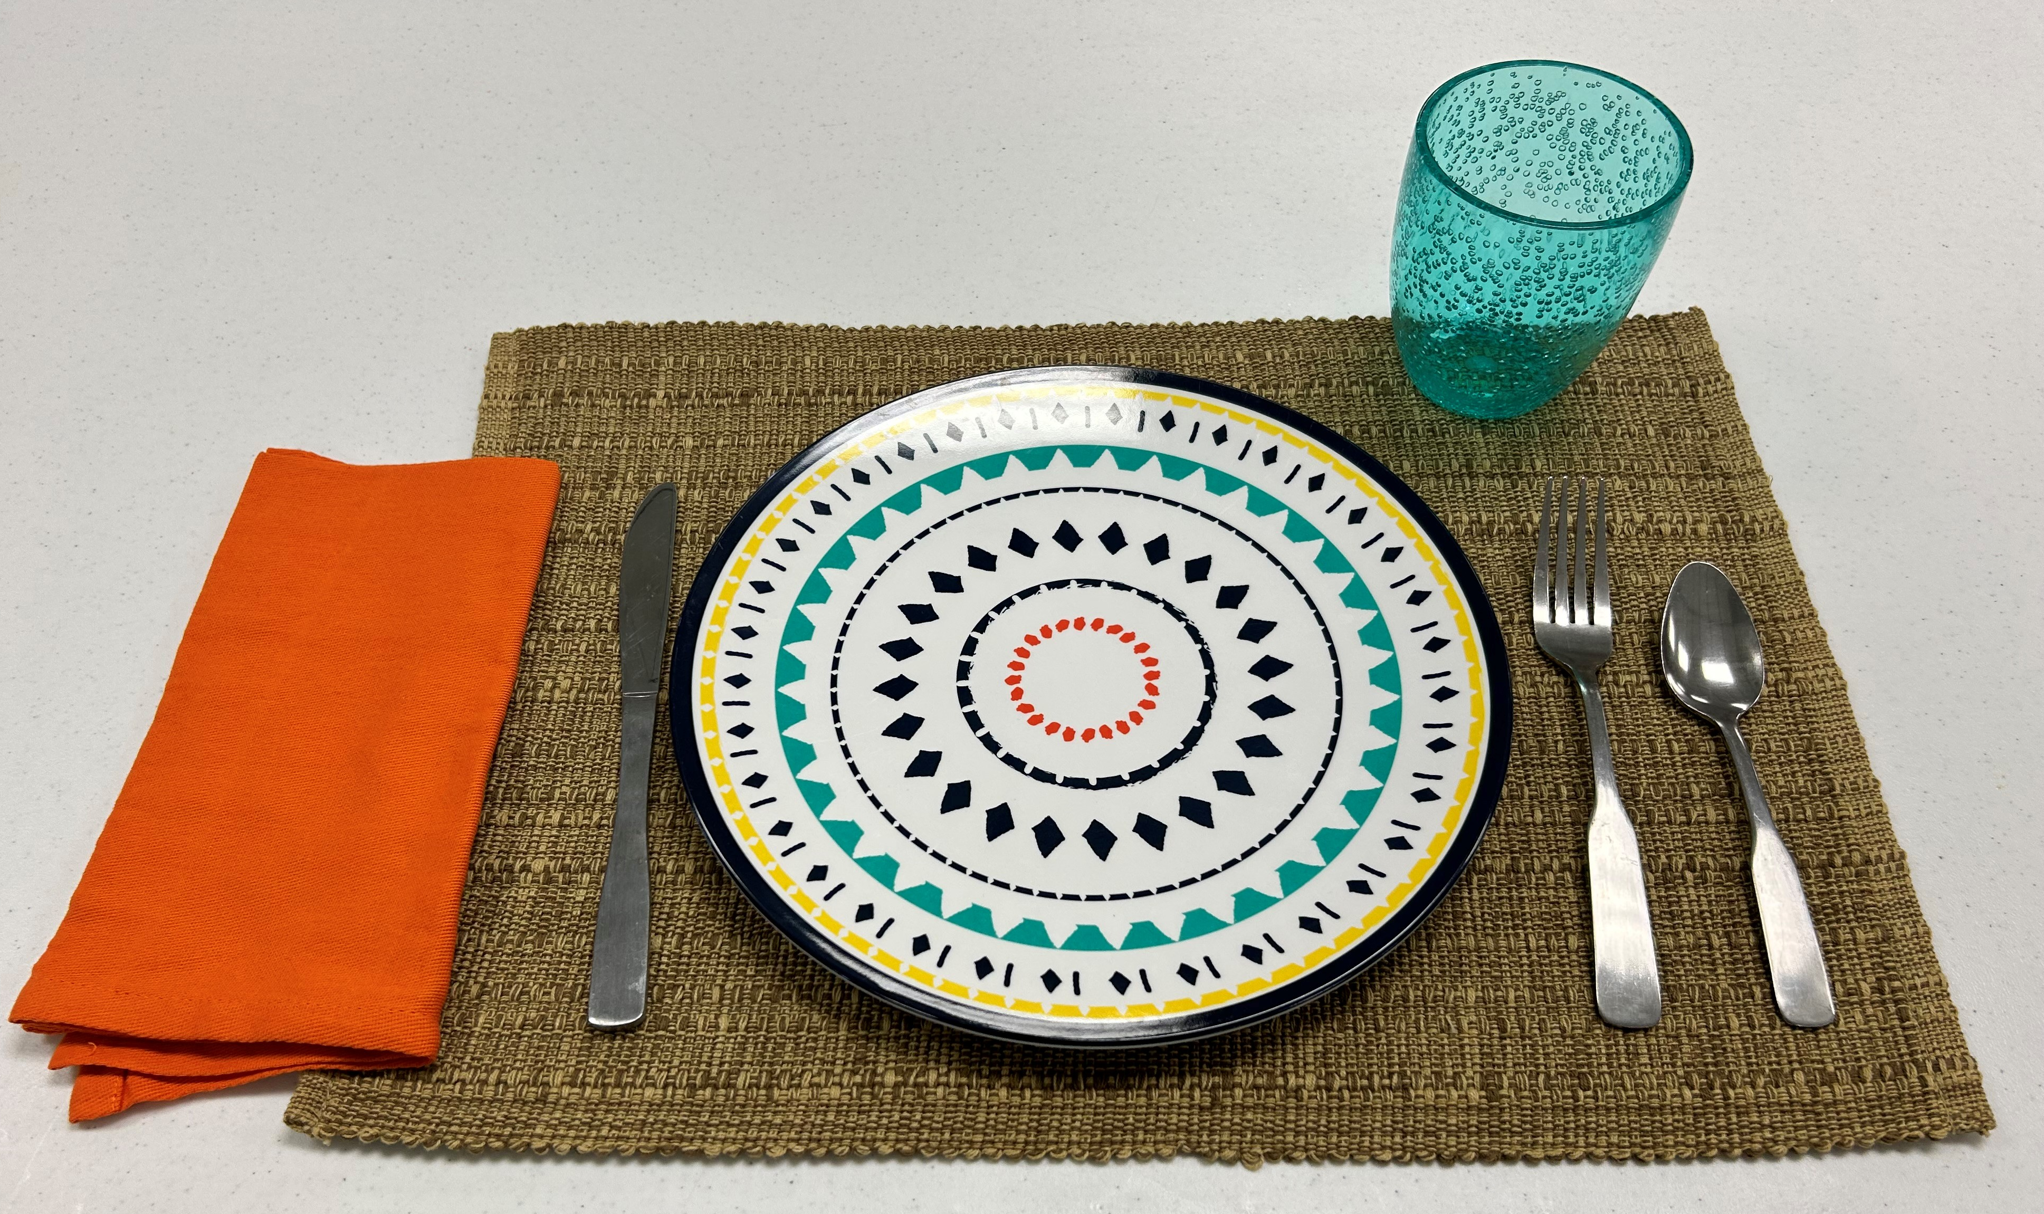
What’s wrong with this place setting?
Notes:
Allow youth to provide feedback as to what is wrong with this picture compared to the previous slide
Listen for:
Placemat should be even with the edge of the table
Fork and Knife have been flip-flopped; fork should be on the left and the knife (blade side towards the plate) should be on the right)
Napkin is folded wrong (upside down) even though it is in the right place – notice the corners.
The napkin, plate, and flatware DO appear to be 1" away from the end of the table.
Cup is in the correct spot

Slide 18
Centerpieces
Required for Junior & Senior members
Keep it simple
Create a theme
Viewed from all sides
Consider height
Centerpiece must be grounded
Notes:
It is easy to think 'flat' when selecting a centerpiece because you are only setting one spot at the table. But anyone sitting at your table should be able to view the centerpiece from any seat.
You want to be able to see the people you are eating with; be sure the centerpiece isn't too tall or wide so that you are having to constantly look the decoration tabletop see who you are speaking with.
Grounded means placing something between the tabletop and the centerpiece. It could be another placemat, napkin, slice of wood, tray, doily, etc. Centerpieces don't sit on the tabletop without something in between.

Slide 19
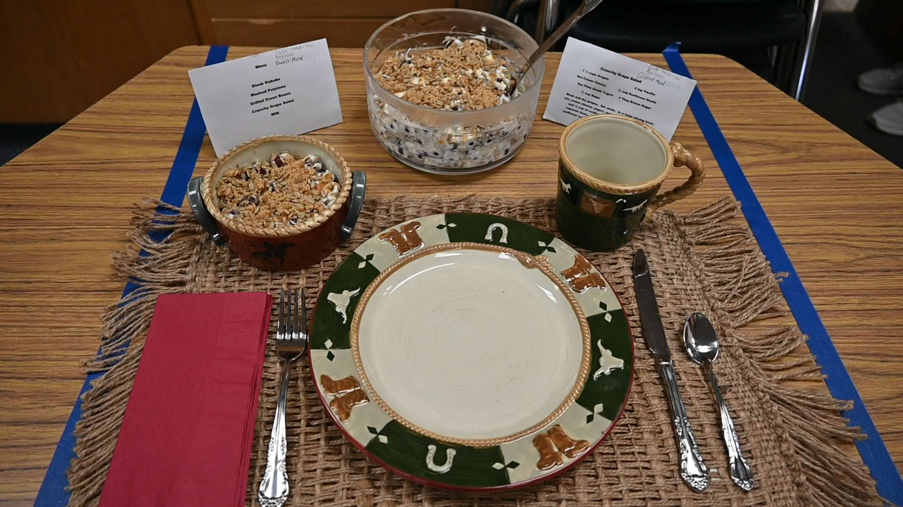
Beginner Place Setting
Notes:
Example of a beginner place setting. There is not a centerpiece included; it is not a requirement for a beginner place setting. If a centerpiece is included at a beginner place setting it will be judged accordingly, potentially resulting in the loss of points.

Slide 20
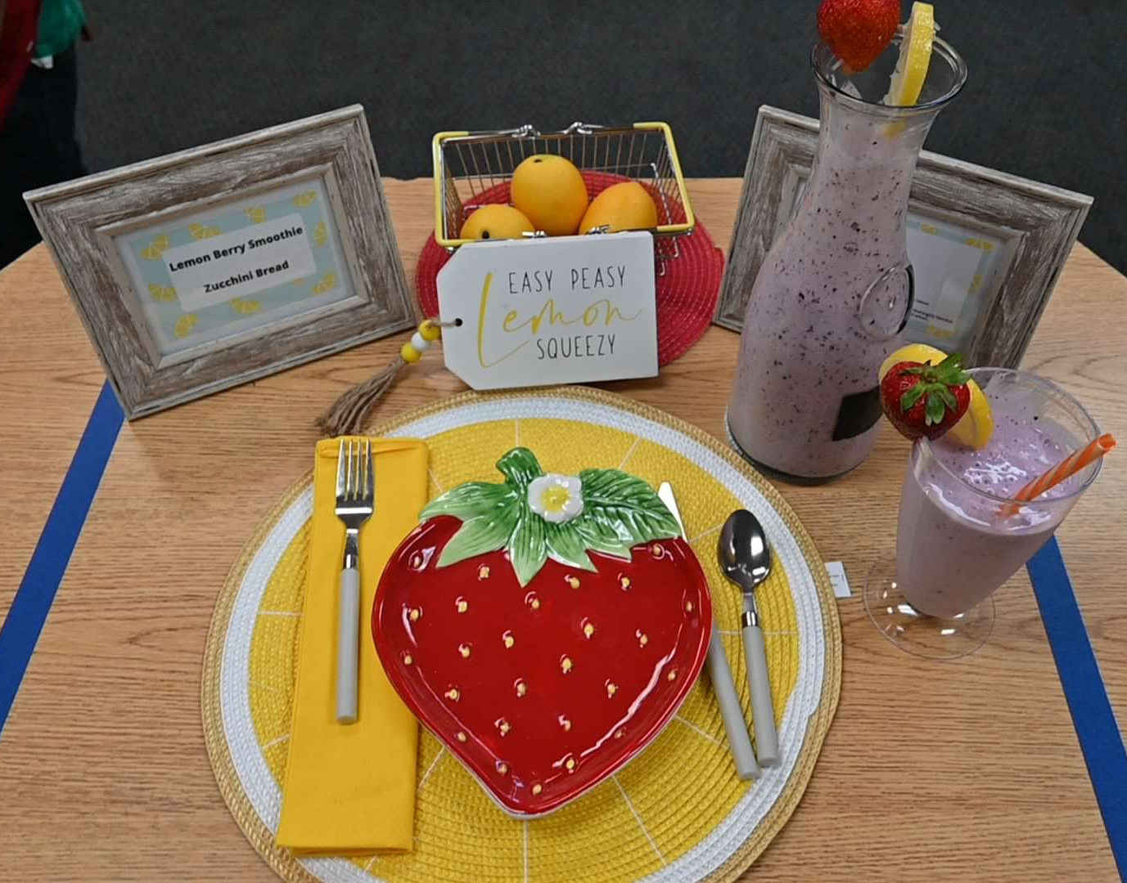
Beginner Place Setting with Centerpiece
What do you see?
Notes:
Good job creating a theme; the recipe is called Lemon Berry Smoothie and they have incorporated colors and fruit (strawberry plate, lemon looking placemat, lemon saying, lemon centerpiece) into their place setting & centerpiece.
Can the centerpiece be seen from all sides? Super cute idea but you can't read the tag from all seats
Round placemats are tricky but do-able
It appears as though the flatware is too far away from the edge of the table; 1" is the rule. Use your thumb (tip to first knuckle) for a handy measuring tool.
Fork should not be place on the napkin
It is OK for the cup to be placed off of the placemat
Serving and Serving Pitcher are both garnished
Serving Pitcher is at the table, as it should be
Menu & recipe are displayed

Slide 21
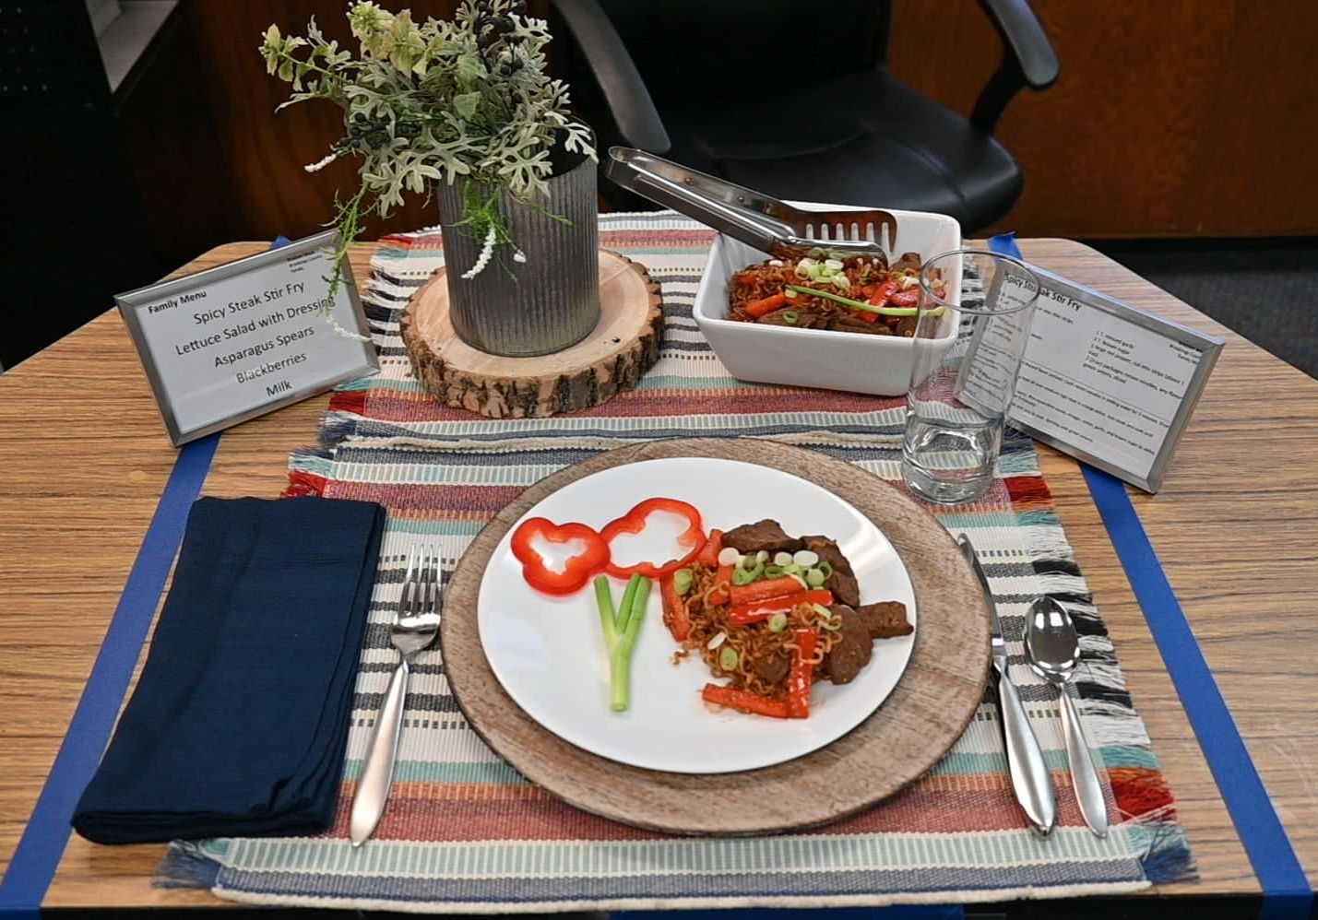
Junior/Senior Place Setting
Notes:
What do you notice here?
Place setting is correct, although the knife should be moved out from under the plate/charger
Centerpiece is grounded and can be seen from all sides. Not too tall or wide
Serving dish is complete with a serving utensil and at the table, as it should be
Serving dish and individual serving are garnished
Menu & recipe are displayed

Slide 22
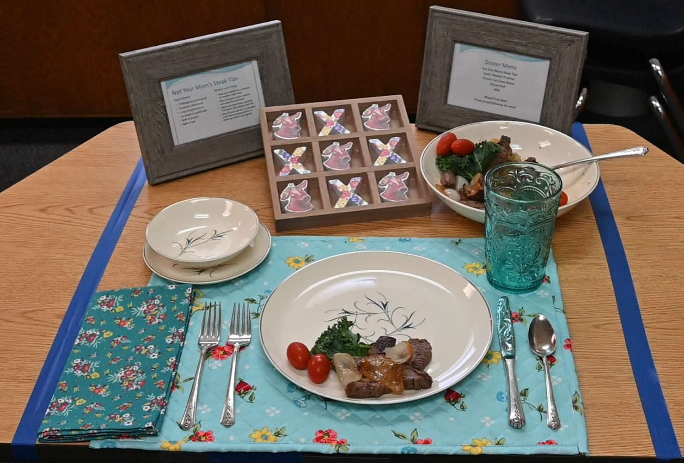
Let’s talk about this centerpiece
Notes:
Good color combination
Can the centerpiece be seen from all sides?
It appears as though the plate is too far away from the edge of the table; 1" is the rule. Use your thumb (tip to first knuckle) for a handy measuring tool.
Serving and Serving dish are both garnished; serving bowl has a serving utensil
Serving bowl is at the table, as it should be
Menu & recipe are displayed

Slide 23
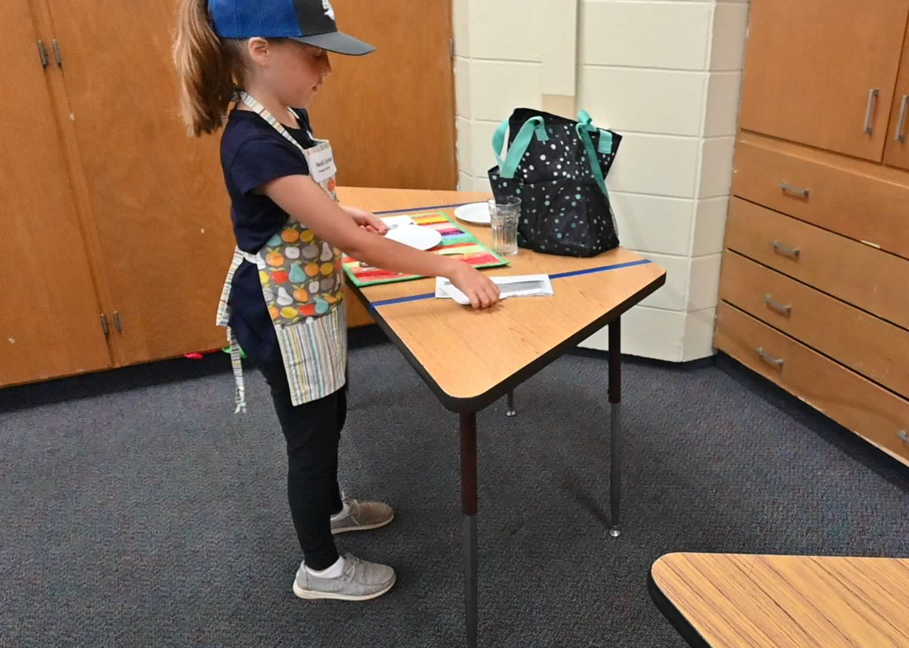
Place Setting
Let’s practice
Notes:
This would be a great opportunity for individual practice (using paper products or a self-provided place setting) followed by a group effort to set a single place setting or work in pairs/small groups to set up several different place settings.

Slide 24
Contest consists of 4 parts: 3
Technique
Aesthetics and Hospitality (Place setting)
Food Quality
Nutrition Interview

Slide 25
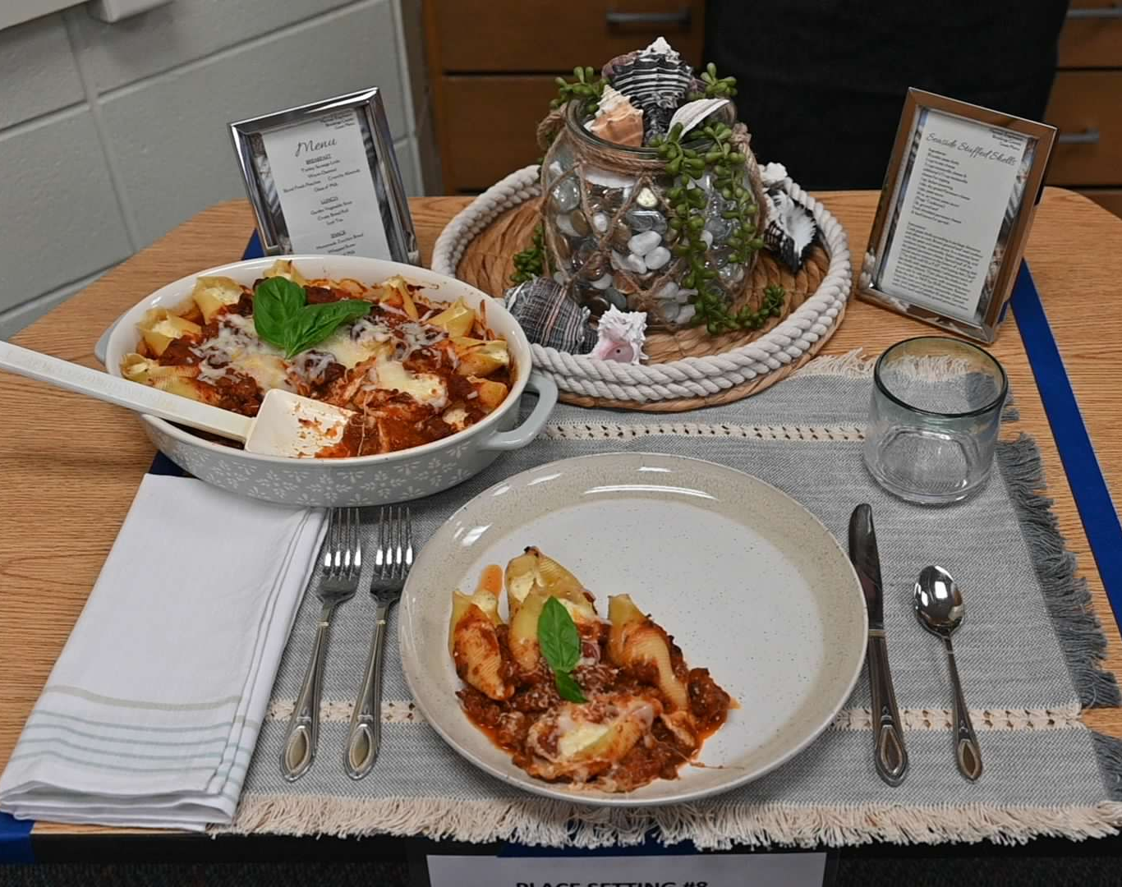
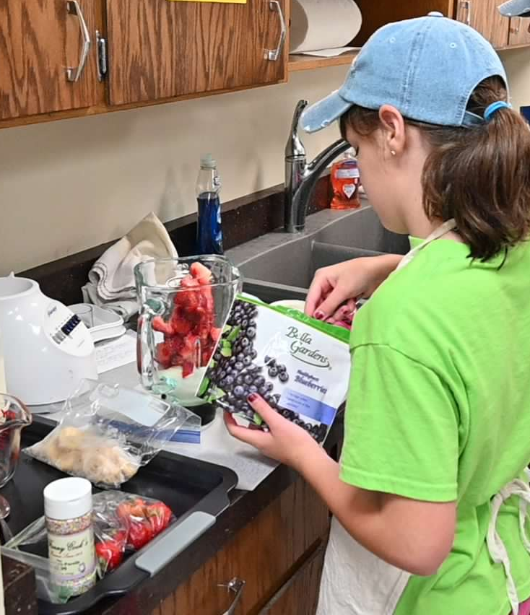
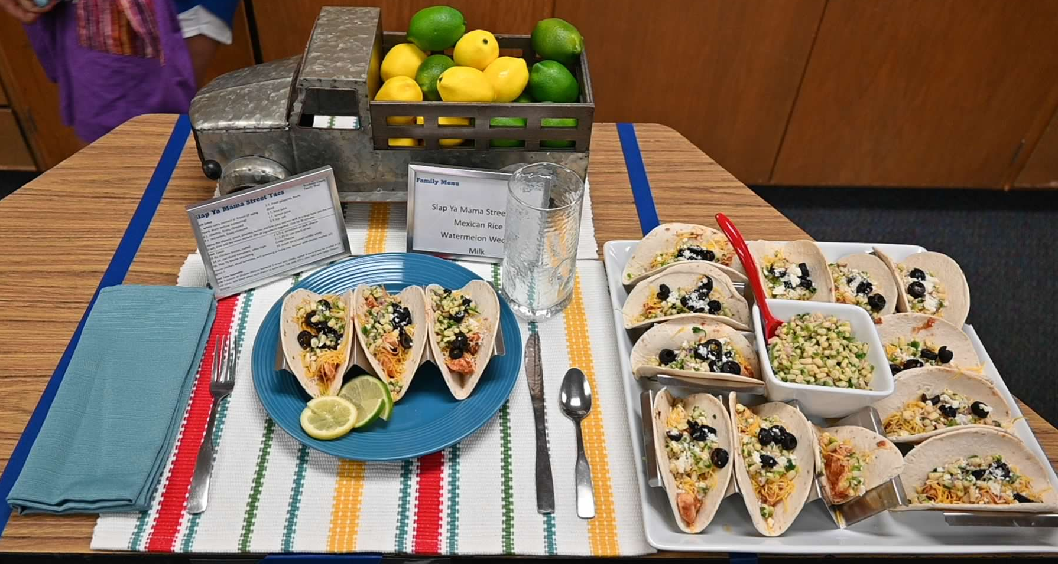
Food Quality
Prepare only one recipe
Judging based on:
  Taste
  Texture
  Appearance (including garnish)
Notes:
Emphasize that the recipe must stay between 2-6 servings.
Incorporate color into your recipe, garnish, place setting, and centerpiece
Be creative with your garnish; this is a great way to introduce a complimentary or splash of color.

Slide 26
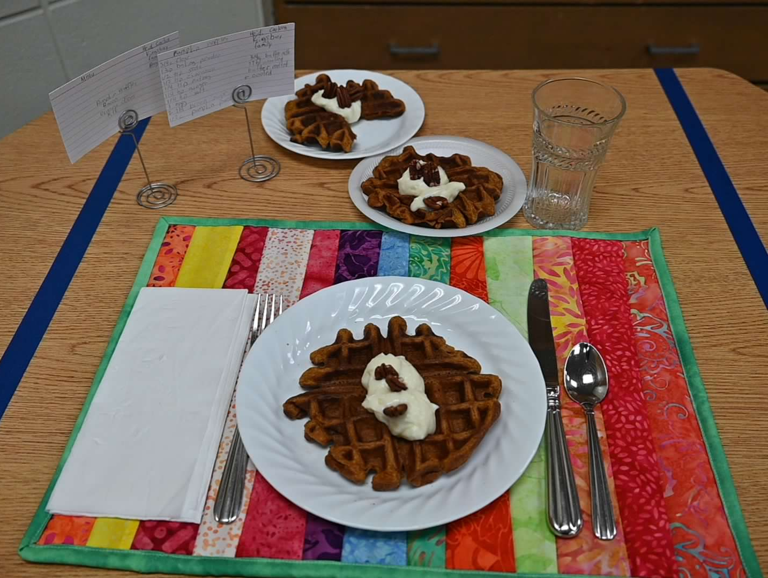
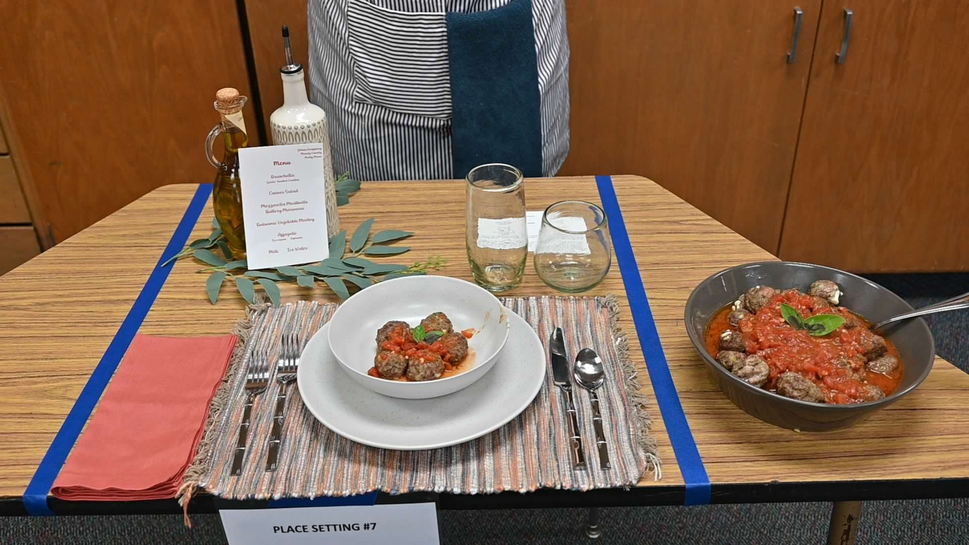
Food Quality - Appearance
Notes:
Examples of recipes on place setting and in serving dish complete with garnish.

Slide 27
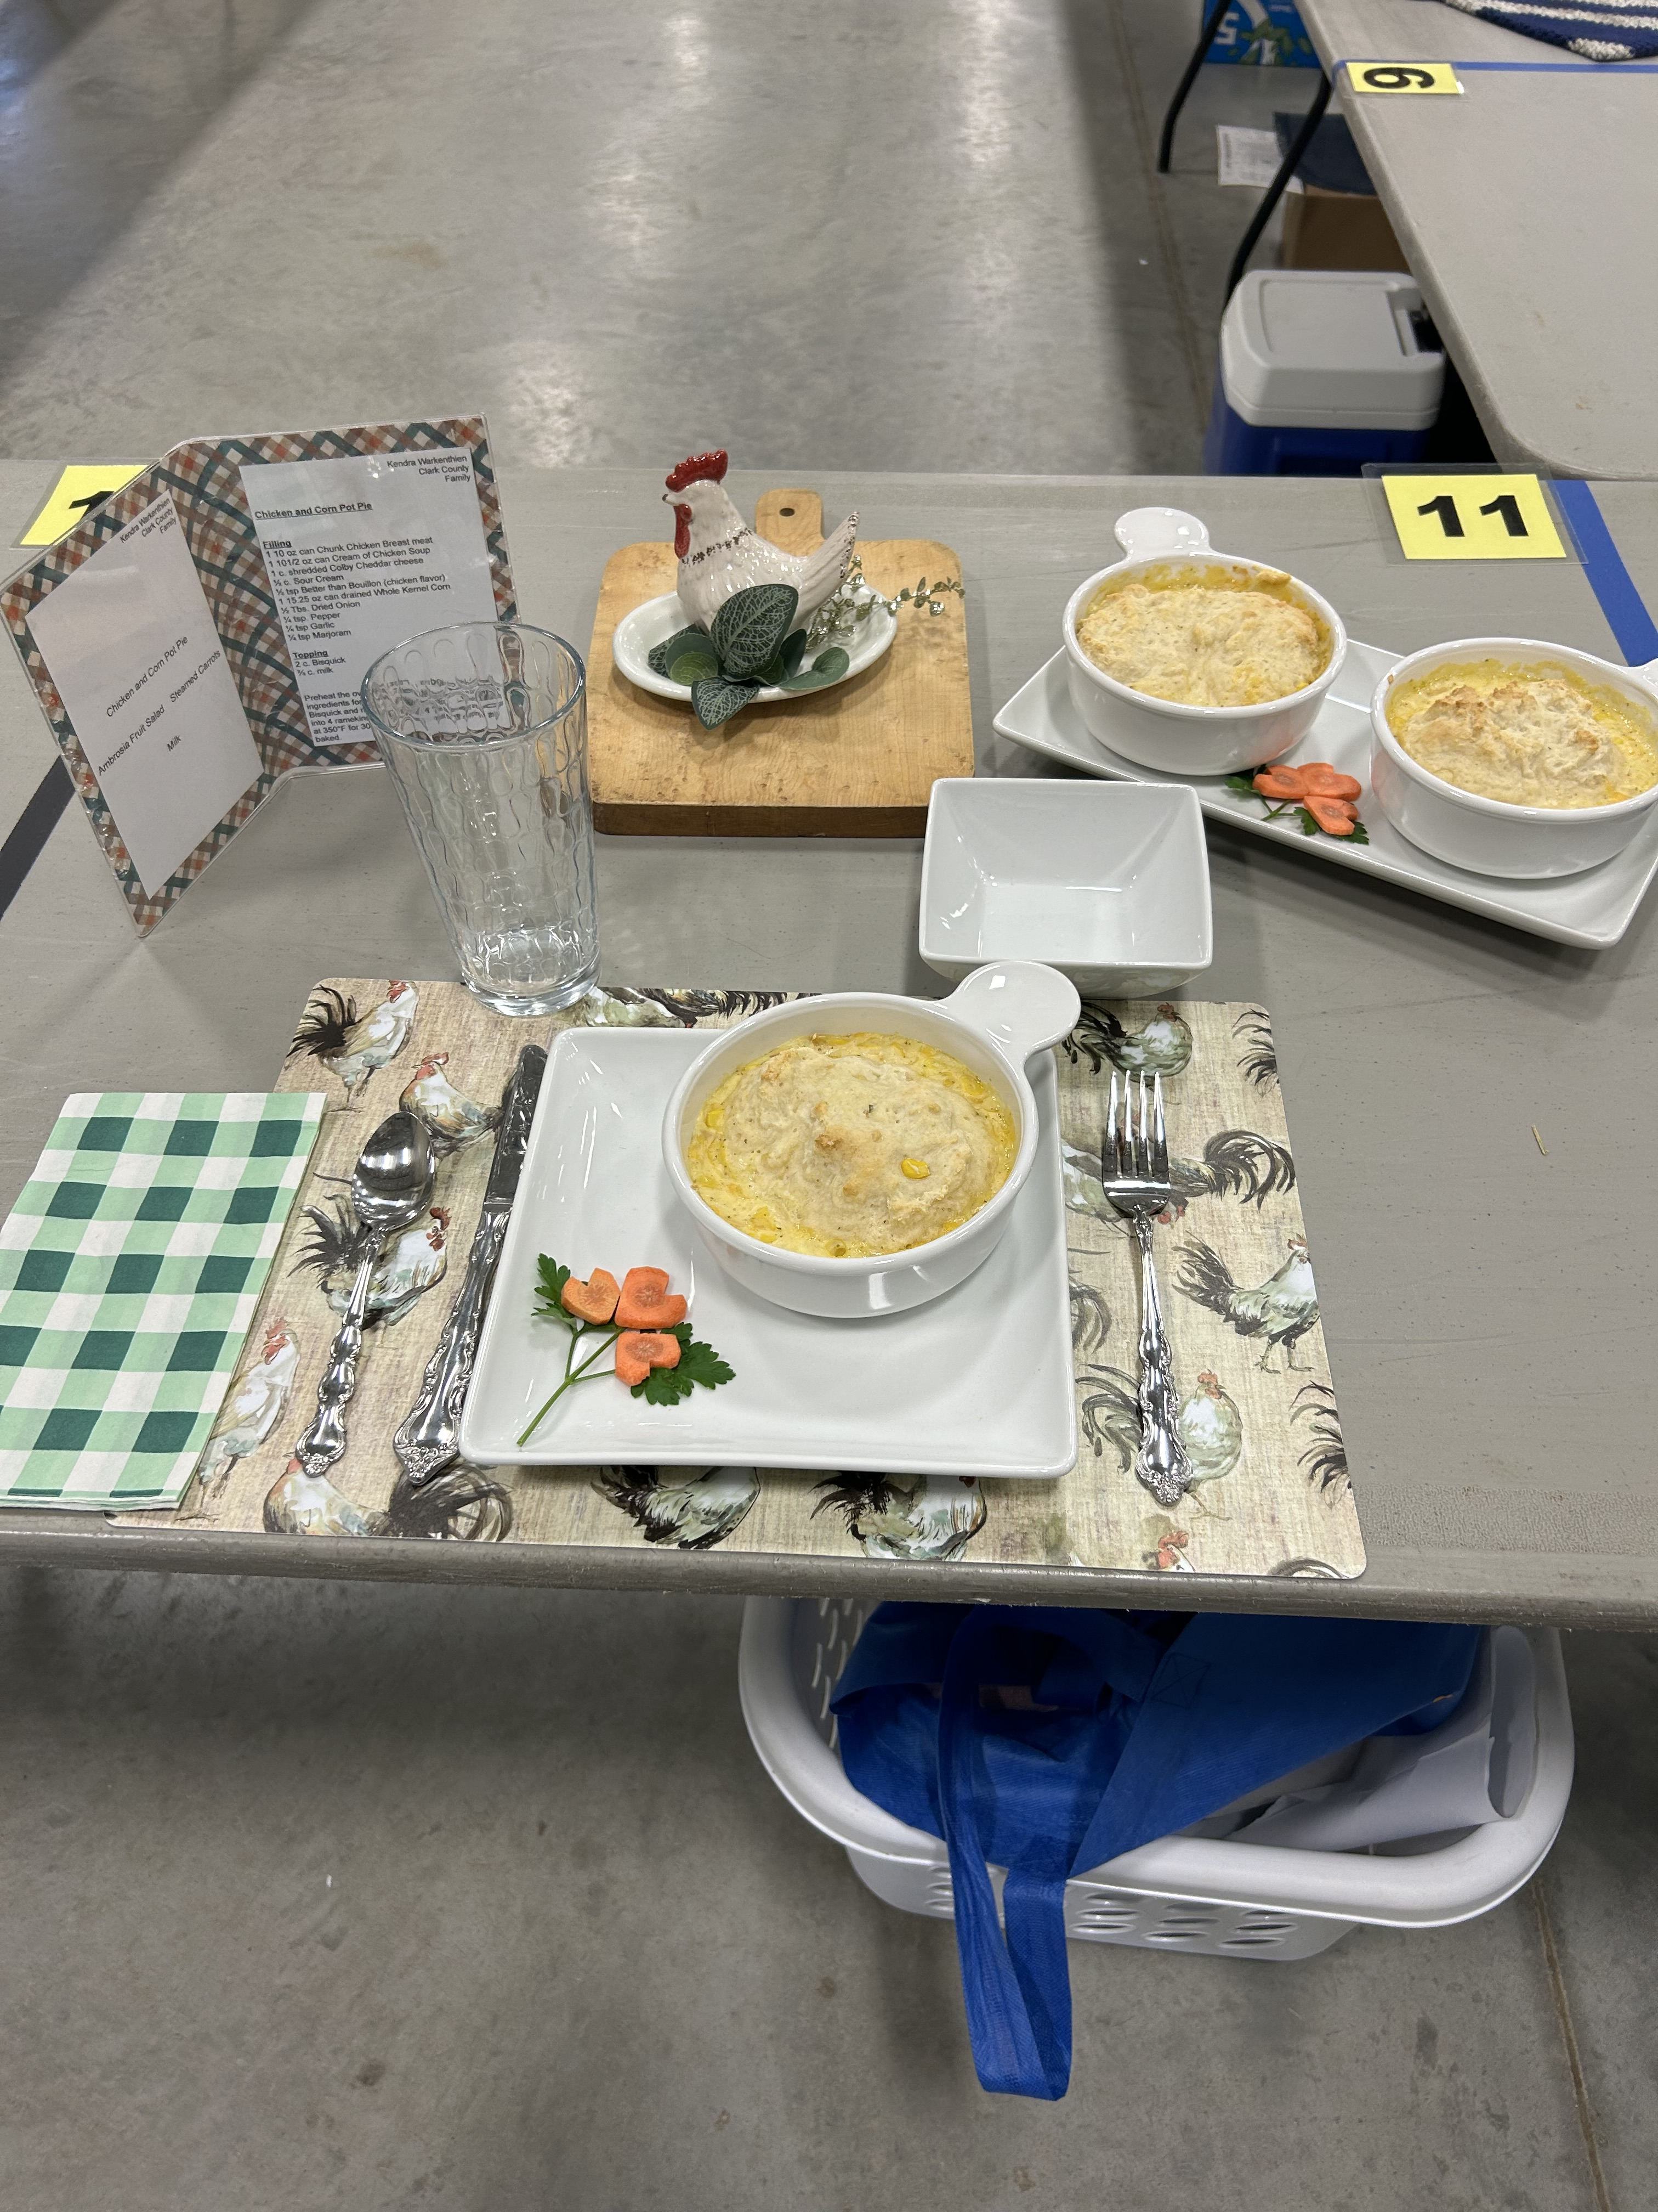
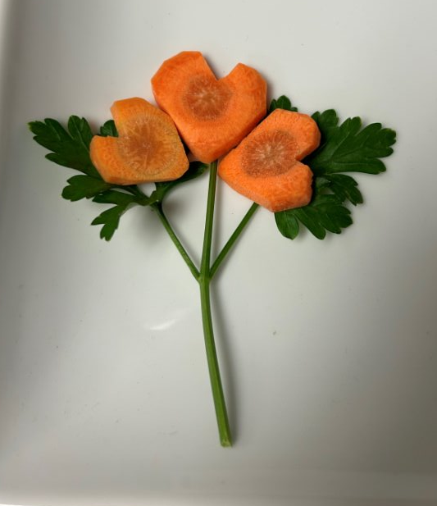
Place setting examples
Notes:
Examples of recipes on place setting and in serving dish complete with garnish.

Slide 28
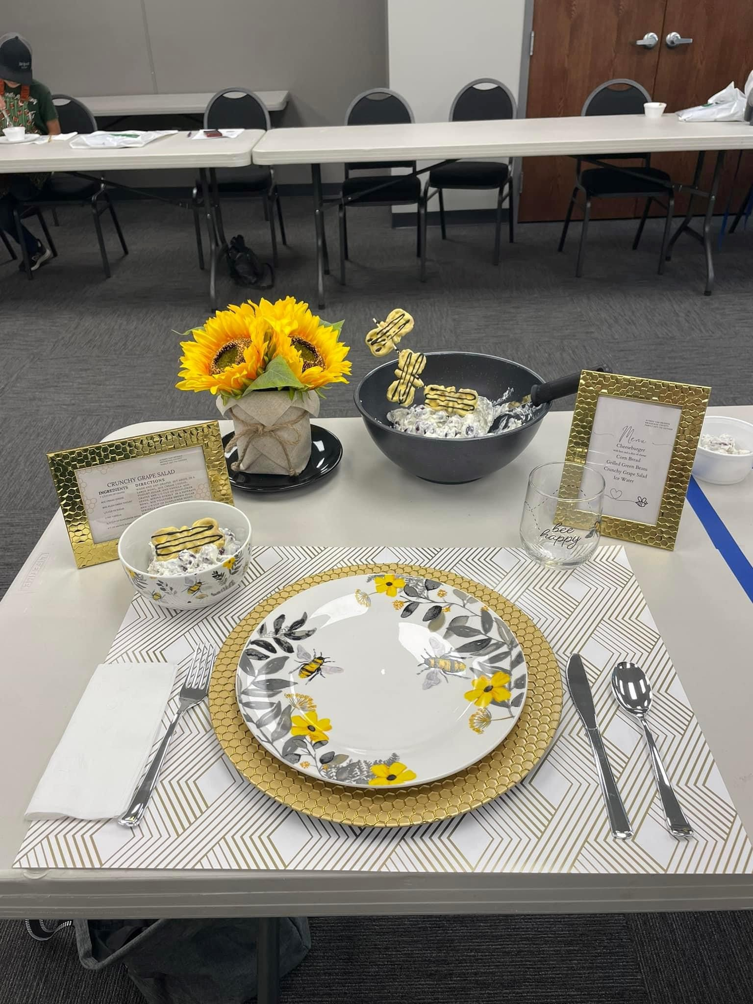
Garnish examples
Notes:
Examples of recipes on place setting and in serving dish complete with garnish.

Slide 29
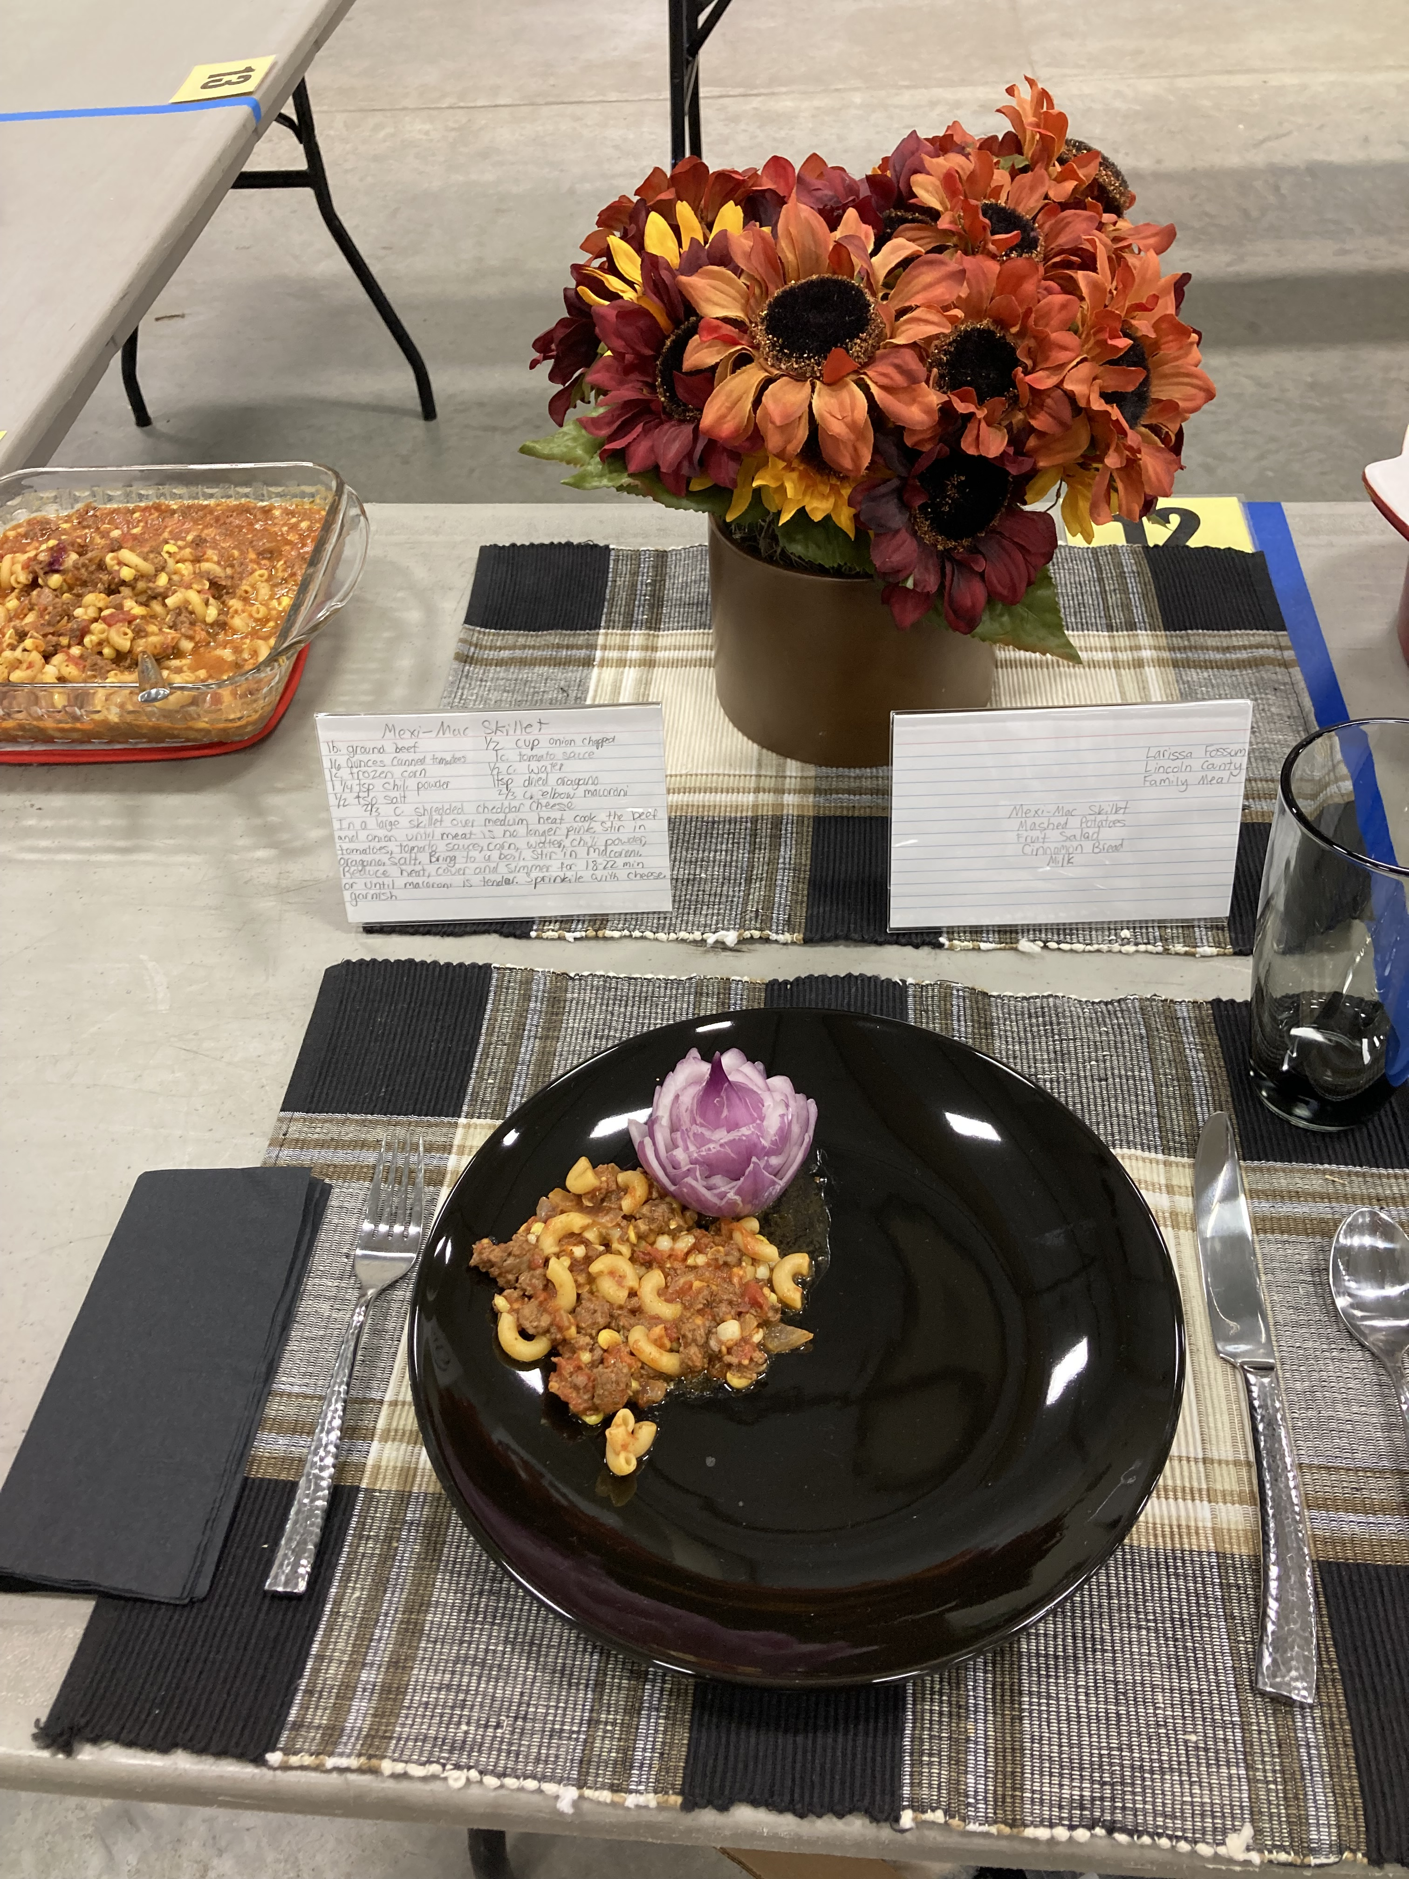
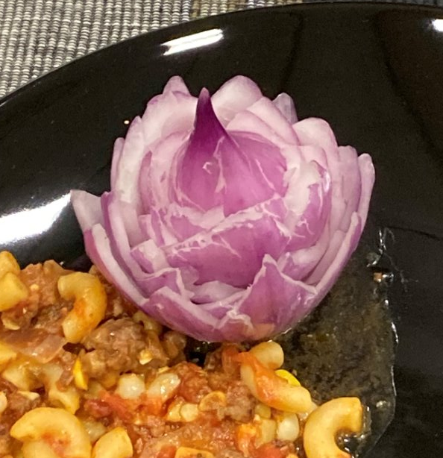
Garnish example
Notes:
Examples of recipes on place setting and in serving dish complete with garnish.

Slide 30
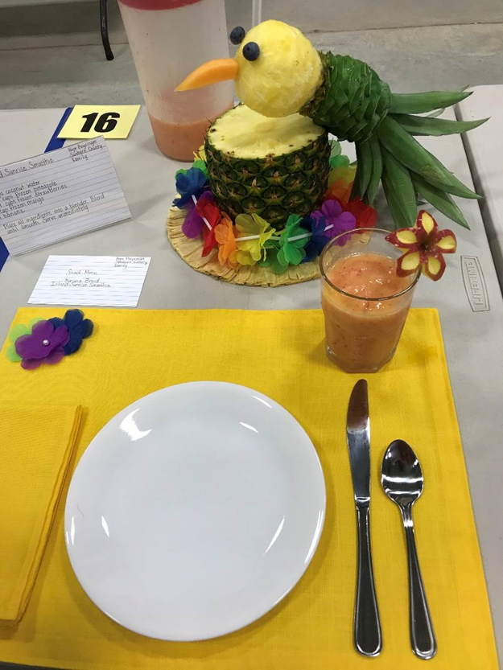
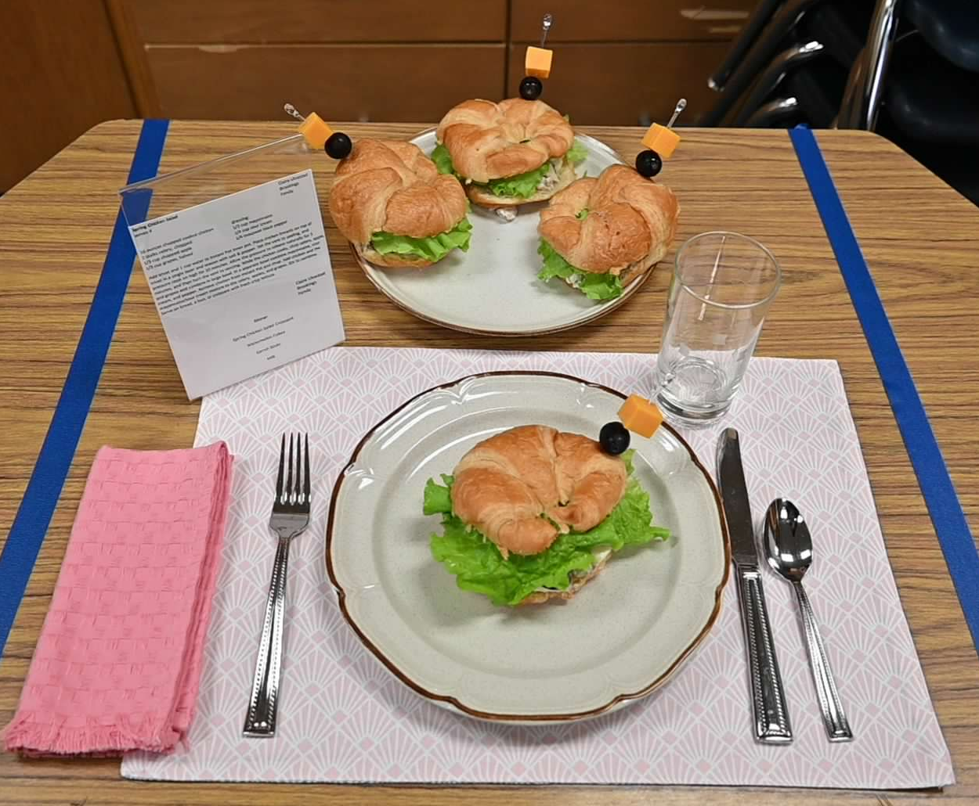
Food Quality – Appearance 2
Notes:
Examples of recipes on place setting and in serving dish complete with garnish.

Slide 31
Contest consists of 4 parts: 3
Technique
Aesthetics and Hospitality (Place setting)
Food Quality
Nutrition Interview

Slide 32
Nutrition
Includes:
  Serving Size Worksheet
  Recipe Worksheet
  Menu Worksheet
  Daily Serving Size Guide
  Nutrition interview:
    Study Dietary Guidelines for Americans in Special Foods handbook (pages 4-11 based on 4-H age)
    Scoresheet (by age division)
    Flash cards
Notes:
Worksheets and guides can be found at https://extension.sdstate.edu/4-h-special-foods-contest

Slide 33

Beyond Special Foods
Culinary & Food Services
  Nutrition
  Pastry Arts
  Restaurant Management
Dietician
Community Health
Food & Meat Science
What other cool career adventures come to mind?
Notes:
Use this slide to introduce the career possibilities beyond the 4-H Special Foods Contest; personalize jobs to your area and ask for youth to contribute their own thoughts. Feel free to highlight 4-H members/youth in your area that have begun their own food based entrepreneurial adventure, for example Hope Karels of Milbank and her business HK Cupcakes.

Slide 34
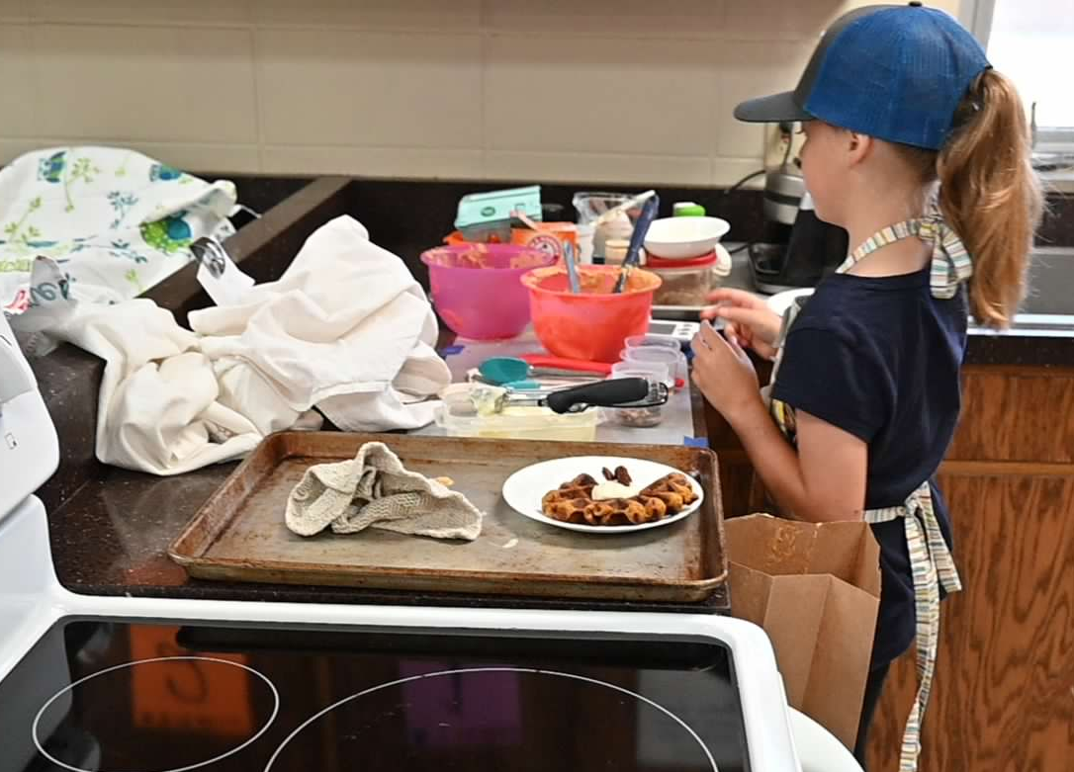
Let’s Cook
Prepare Food
Garnish
Finish place setting
Sample

Slide 35

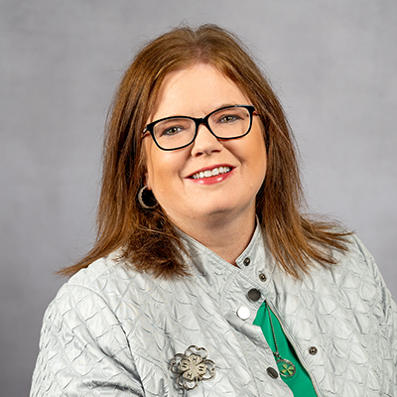
4-H Special Foods Co-Chairs
Sonia Mack
SDSU Extension 4-H Educator - Brookings County
Sonia.Mack@sdstate.edu
605-693-8280
Jodi Loehrer
SDSU Extension 4-H Educator - Codington County
Jodi.Loehrer@sdstate.edu
605-882-6300

Slide 36
And Justice for All

Slide 37
And Justice For All - Spanish

