Slide 1

The information in this PowerPoint is adapted from:
Utah State 4-H
Leadermete 2005
Darrell Rothlisberger
Rich County Extension Agent
435-793-2435 darrellr@ext.usu.edu
Livestock Judging
Just the basics

Slide 2
What is Livestock Judging?
Analysis of animals and measuring them against a standard that is accepted as ideal
Three parts
  Making observations
  Organizing thoughts
  Expressing opinion via oral reasons

Slide 3
Steps of Judging Livestock
Criteria
Hormel system and scoring
The three species
Oral Reasons and Notes
Terms
Contest!

Slide 4
Skills Developed in Judging Livestock
Confidence
Decision Making
Self Esteem
Communication
Critical Thinking
Industry Knowledge
Career Exploration
Nomenclature

Slide 5
Livestock Judging
“Judging instills the confidence in those people who may be timid and humbles those who tend to be conceited.” – Harlan Ritchie

Slide 6
Four Steps in Judging Livestock
Information
  What is the use for the class
Observation or evaluation
  How does each animal meet the market standard
Comparison
  Each animal must be compared to the other three
Conclusion or placing
  Arrive at a logical placing

Slide 7
Basic Judging Criteria
Four animals in a class
  Numbered 1- 4 from left to right when viewed from the rear when tied, in stanchions or racks.
  Or clearly marked by
    1, 2, 3, 4
    ⏐, ⏐⏐, ⏐⏐⏐, ⏐⏐⏐⏐

Slide 8
Basic Judging Criteria
(Market and breeding classes)
Three species judged in market and breeding classes
Beef
  Sheep
  Swine

Slide 9
Basic Judging Criteria (Strategy)
Strategy
  Evaluate from a distance of 20 to 30 feet
  Handle animals if appropriate to confirm placing
  Go with first impression

Slide 10
Basic Judging Criteria (Time)
A Class is about 12 minutes in length
First 2 minutes should be at a distance
The next three minutes should be to confirm and write down placings.
The rest of the time should be used to write down notes for reasons.

Slide 11
Basic Judging Criteria
(Hormel system)
  The Hormel system and the judging card.
  Each class is worth 50 points for the placing.
  Each set of reasons is worth 50 points.
  Classes are divided into three “pairs”
    Top, Middle and Bottom

Slide 12
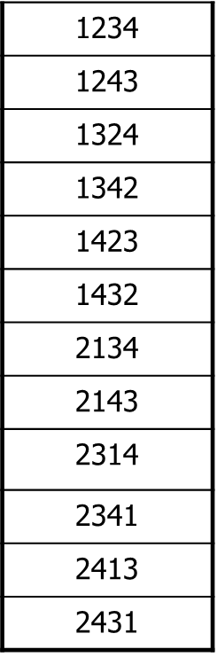
Basic Judging Criteria (Hormel System Examples)
The Hormel System
  There are 24 different possibilities to place four animals.

Slide 13
Cuts
What are CUTS?
  The penalty for switching top, middle and bottom pairs.
  These form the basis for grading or scoring the placing.
  Will never exceed 15 points when added together

Slide 14
Scoring
Class is placed 2 1 4 3
The correct placing is 2 1 3 4
With cuts of 2 3 5
Score is 45

Slide 15
Scoring Example
Class is placed 2 1 4 3
The correct placing is 1 2 3 4
With cuts of 3 4 6
Score is 41

Slide 16
Basic Judging Criteria
(What to look for?)
What to look for?
  Frame
  Muscle
  Balance
Finish (market classes)
Structural Correctness
Breed and Sex Character

Slide 17
The Four Species
Beef
  Breeding and Market
Swine
  Breeding and Market
Sheep
  Breeding and Market
Goats
  Breeding and market

Slide 18
The Four Species, continued
Each species has several different breeds
There are different characteristics and therefore terminology with respect to market and breeding

Slide 19
Oral Reasons
Teach you to organize your thoughts and defend your decision to a reason taker
Maximum time is two (2) minutes

Slide 20
Benefits from Reasons
Think more clearly
State your thoughts more expertly
Improve your speaking voice
Develop memory

Slide 21
Points to Consider
Keep reasons short and to the point
Be descriptive and complete
Avoid works and phrases that do not add meaning
Be comparative
Discuss only the things which you observed
Tell the truth!!

Slide 22
Transition Terms
Words or phrases that help your reasons flow more smoothly.
Allows reasons taker to follow your thoughts more easily
Use voice inflection

Slide 23
Transition Terms List
Plus
Moreover
As well as
In addition
Furthermore
However
I criticize
I recognize
I grant
Additionally

Slide 24
Taking Notes
Develop your own system
So you remember
For example
  BT = big top
  SS= size and scale
  BF = bigger frame
  VD = vertical dimension

Slide 25
The Grid
Class | Placing
Pair | Comparison | Grants / Criticize
1 / 2
2 / 3
3 / 4
4

Slide 26
Reasons Format
Pleasant to hear
Easy to listen to
Easy to follow
Cover major points in the class
Given in comparison terms
Breaks a class of four animals into three pairs
  Top, middle, bottom
Each pair is discussed in three areas
  General or broad statements
  Reinforcements or specific statements
  Grants or criticisms

Slide 27
Top Pair
General Statement
  Tell reason(s) for placing 1 first and over 2 in the top pair
Reinforcements
  Go into more detail to further describe your general statement
Grants
  Was 2 better than 1 in any area?
Criticize 2

Slide 28
Middle Pair
General Statement
  Tell reason(s) for placing 2 over 3.
Reinforcements
  Go into more detail to further describe your general statement
Grants
  Was 3 better than 2 in any area?
Criticize 3

Slide 29
Bottom Pair
General Statement
  Tell reason(s) for placing 3 over 4.
Reinforcements
  Go into more detail to further describe your general statement
Grants
  Was 4 better than 3 in any area

Slide 30
Bottom Animal
Explain why it is the last place animal
Compare to the rest of the class
In “est” terms
  Smallest framed
  Lightest muscled
  Structurally most incorrect

Slide 31
The End of your Reasons
Always Say thank you! ☺

Slide 32
Performance classes
Scenario Format
Should answer three questions
  What purpose
  What situation
  What priorities
No reasons
Keep/Cull
EPD’s

Slide 33
Question Classes
No Reasons
Written Questions
  Which is heavier muscled between 1 and 2?
  Which steer had the white tag?

Slide 34
Let’s Practice! Pencil Class
Criteria:
  Susan is preparing for a big test in math. She needs to bring a #2 pencil and has four options in her pencil bag. She knows she needs a sharp pencil with an eraser that can be sharpened again if necessary. Because she is a proud 4-H member, she likes to support 4-H whenever she can. Please place this class of pencils.

Slide 35
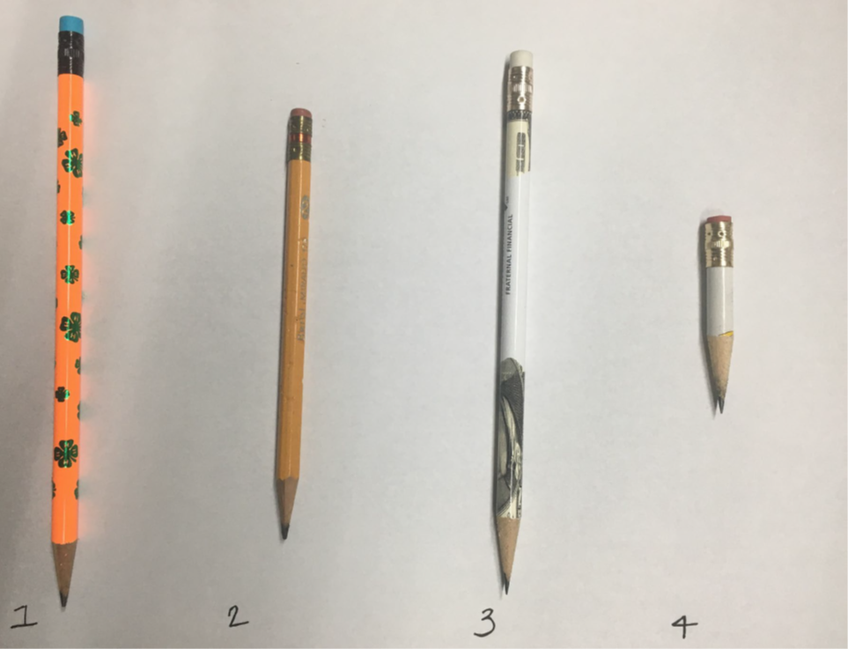
Class 1: Pencils

Slide 36
Officials & Reasons
1-3-2-4 Cuts: 2-4-3
Reasons:
  I placed the pencils 1-3-2-4. Starting with the 4-H pencil that has the most complete eraser and is the longest.
  In my top pair, I placed 1 over 3, the 4-H pencil allows Susan to show her 4-H pride while also having a more complete eraser. I grant that 3 appears to have a sharper point, but the pattern isn’t as appealing, and the eraser appears to be slightly used.
  Still, I easily selected it over 2 in my middle pair. The longer pencil is free of bite marks and have a sharper point and is longer. I appreciate that 2 is definitely a #2 pencil, but the bite marks and limited eraser mean I can’t move it any higher in the class.
  Yet, I still placed it over 4 in my final decision. The yellow pencil is much longer and has a bigger eraser. I appreciate that the short pencil is much sharper and free of blemishes, but sadly it is short and has no useable eraser.

Slide 37
And Justice for all

Slide 38
And Justice for All - Spanish

